Slide 1


Software Architecture - Principles and Practices Day 1
Mateusz Dymiński

Slide 2

Agenda

Slide 3
Agenda
Intro
Software Architect and Architecture definitions/level/roles
Architecture Documentation and Metrics
Company Culture
Key Software Development Concepts
Domain Driven Design
Event Storming
Tips and Tricks

Slide 4
whoami
Mateusz Dymiński
Software Developer(Architect) at Nokia
>10 years in industry
>6 years Java dev
>7 years Go dev
Still writing code : )
Tech confs speaker
LinkedIn, GitHub, FB, Twitter - see https://mateuszdyminski.com/

Slide 5

Materials: presentations, sources etc.
https://github.com/mateuszdyminski/architecture

Slide 6

General rules of training

Slide 7
General rules
Training: 3 x 7h
Short breaks after sessions - 1h – 3-5mins
One long break for lunch – around 1pm ?
Ask questions anytime
Few small assessments to keep you warm-up
No present list : )

Slide 8

Let's introduce ourselves

Slide 9
Exercise

Slide 10
Exercise
Think about architecture challenge which you would like to discuss
Write it down
Write down requirements/context
Functional requirements
Non-functional requirements
Constraints?
Time
Budget
Technology/Tools
Organisational/People
Send it to me - mail/zoom

Slide 11
Exercise
At the end of the day we’ll simulate the Architecture Guild
We’ll try to discuss one of your problems
We’ll create RFC with the solution/decision

Slide 12

Software Architecture

Slide 13
Software Architecture
There is no better or worse architecture
it all depends on the context

Slide 14
Software Architecture
but definition!

Slide 15
Software Architecture
Software architecture refers to the fundamental structures of a software system and the discipline of creating such structures and systems. Each structure comprises software elements, relations among them, and properties of both elements and relations.^{[1]} The architecture of a software system is a metaphor, analogous to the architecture of a building. It functions as a blueprint for the system and the developing project, laying out the tasks necessary to be executed by the design teams.
Source: https://en.wikipedia.org/wiki/Software_architecture

Slide 16


Slide 17
Software Architecture
Architecture is shared understanding of people on the project
Ralph Johnson on the Extreme Programming mailing list
More: https://martinfowler.com/ieeeSoftware/whoNeedsArchitect.pdf

Slide 18
Software Architecture
This understanding includes how the system is divided into components and how the components interact through interfaces
These components are usually composed of smaller components
The architecture only includes the components and interfaces that are understood by all the developers

Slide 19
Software Architecture
No shared understanding means:
Developers are in the mist
Features are glue somewhere
No one understands how system works
No one understands his/her role
The system lives its own life
Developers are focus only on nearest task and doesn’t care about anything else

Slide 20
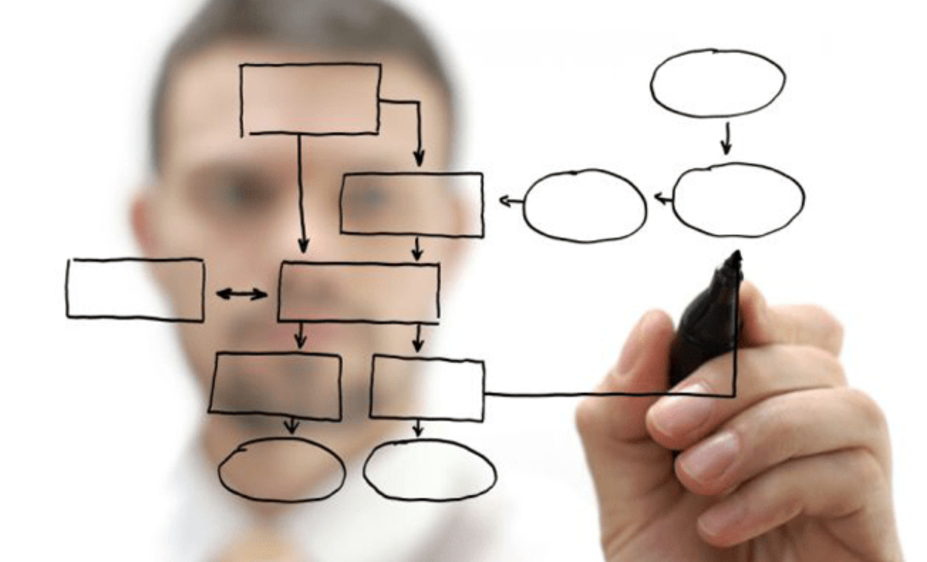
We need solution architect
And enterprise architect
Source: https://boxboat.com/2021/03/04/day-in-the-life-boxboat-solutions-architect/

Slide 21

Types of Architecture

Slide 22
Types of Architecture
Application architecture
Solution architecture
System architecture
Infrastructure architecture

Slide 23
Application architecture
Architecture at single component level
Not always single repo/project/deployable artifact
3 layers/microkernel/hexagonal/modular/pipes&filters architecture
Technology
Programming language
FP vs OOP
Persistency
Communication

Slide 24
Solution architecture
Concept – usually diagram without lines and arrows ☺
Strategic decisions
Project drivers
Team
Dependencies
Technology
Money
Visualizations
C4, BPMN, UML
Project dependencies
Coordinating between products
Timeline

Slide 25
System architecture
Monolith vs Distributed System
Monolith
Old manner monolith
Modular monolith
Distributed System
Microservices
Communications between components
Queues
REST
RPC
Enterprise Service Bus

Slide 26
Infrastructure architecture
Deployment
Single deployment vs multiple deployments
Release cycles
Continuous delivery
GitOps, GitSecOps etc.
Public Cloud vs On-prem Cloud
On-prem servers vs Cloud servers
Monitoring, Metrics, Logs

Slide 27

Software Architect

Slide 28
Software Architect
Make Architecture Decisions
Continually Analyse the Architecture
Keep Current with Latest Trends
Ensure Compliance with Decisions
Have Business Domain Knowledge
Possess Interpersonal Skills
Understand and Navigate Politics

Slide 29

Try not to become Astronaut

Slide 30
Try not to become Astronaut
Keep Current with Latest Trends
Write Code
Check MRs/PRs
Balance between code and decisions
VS Code > PowerPoint

Slide 31

Company Culture in Context of Software Architecture

Slide 32
Company culture
Law of Software Architecture
Analyzing Trade-Offs
Conway's Law
Architecture vs Design
Technical Breadth
Understanding Business Drivers
Architecture Guild

Slide 33
“Everything in software architecture is a trade-off. ” Law of Software Architecture

Slide 34
Conway’s Law

Slide 35
Conway’s Law
„Any organization that designs a system (defined broadly) will produce a design whose structure is a copy of the organization’s communication structure.”

Slide 36
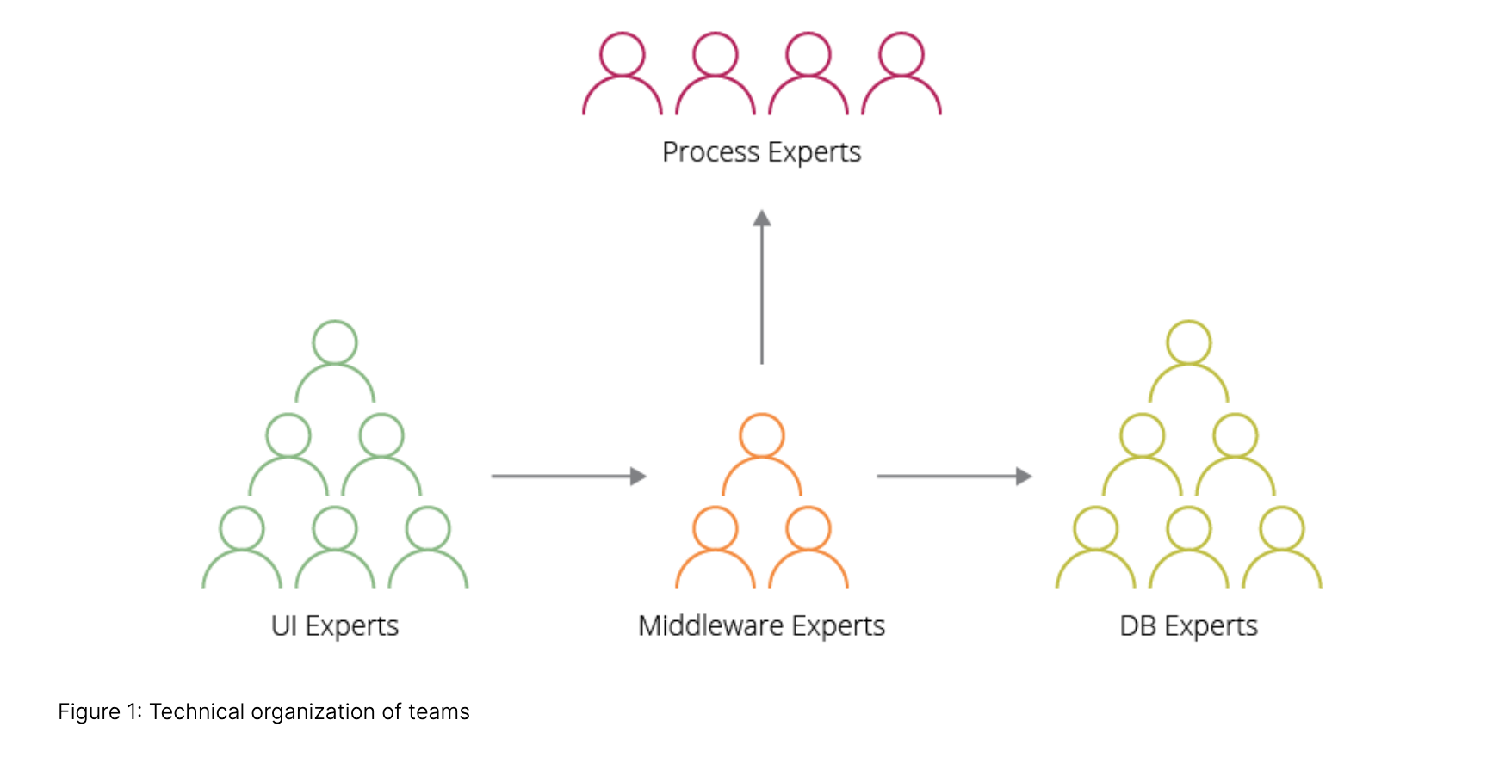
Conway’s Law
Source: https://www.thoughtworks.com/insights/blog/applying-conways-law-improve-your-software-development

Slide 37
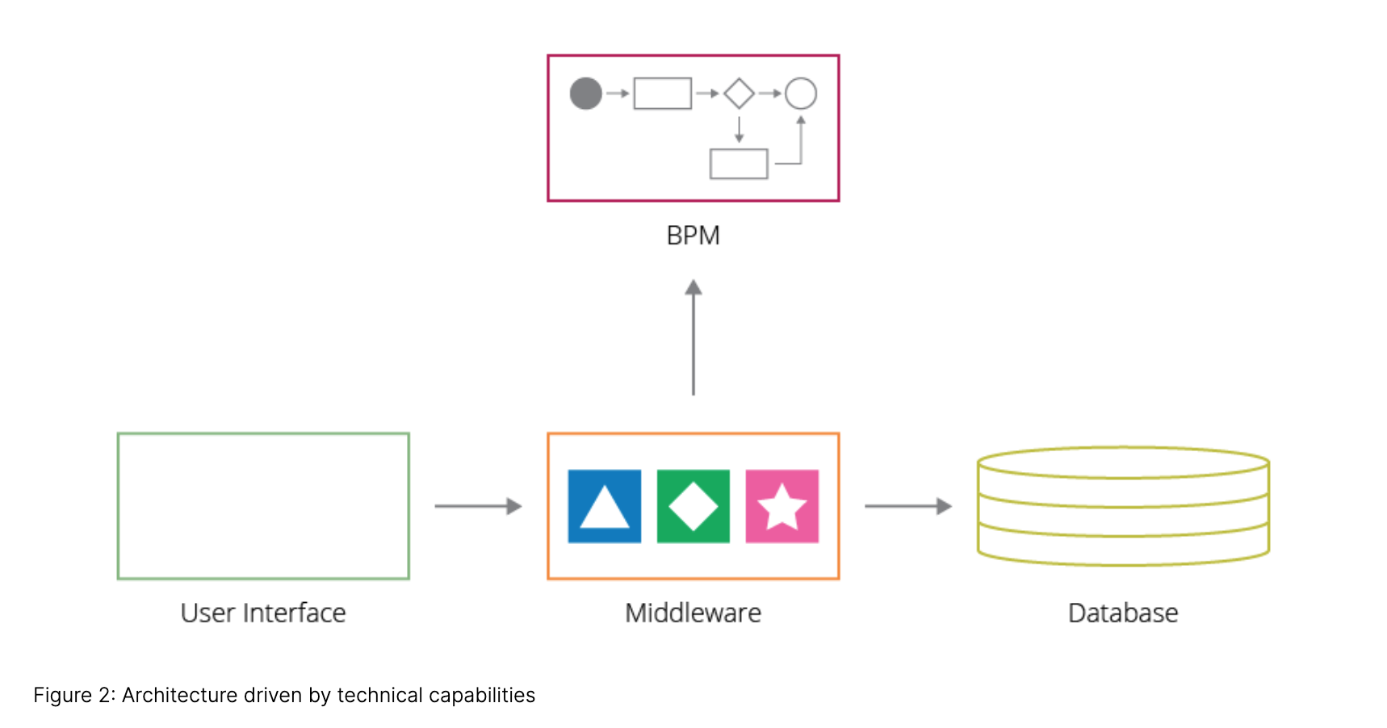
Conway’s Law
Source: https://www.thoughtworks.com/insights/blog/applying-conways-law-improve-your-software-development

Slide 38
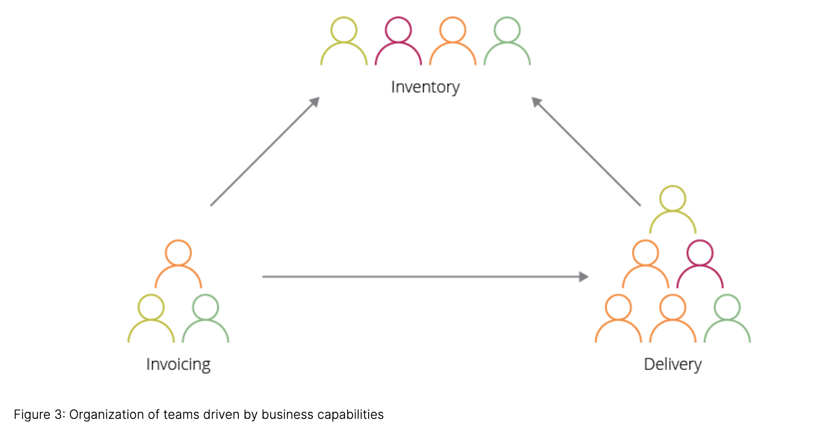
Conway’s Law
Source: https://www.thoughtworks.com/insights/blog/applying-conways-law-improve-your-software-development

Slide 39
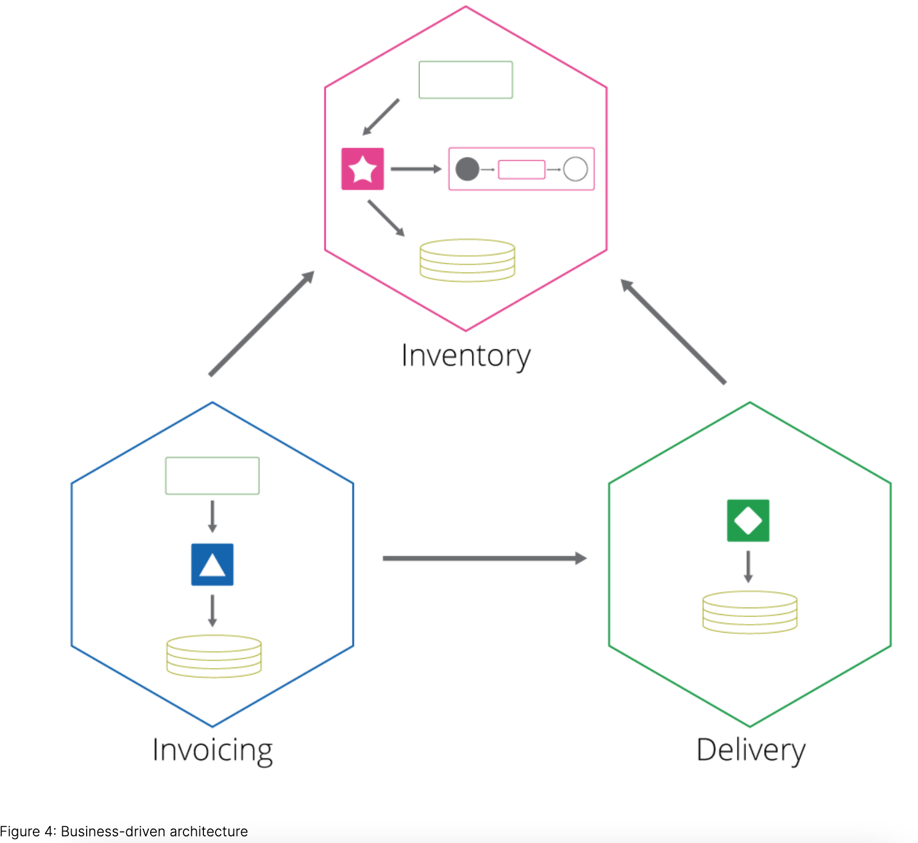
Conway’s Law
Source: https://www.thoughtworks.com/insights/blog/applying-conways-law-improve-your-software-development

Slide 40
Conway’s Law - recap
Communication is most important in context of architecture of complex systems
It supports cross-functional teams
It supports DevOps culture
The more people in a team with a wider spectrum of solution solving skills, the fewer dependencies from other teams and unnecessary delays
If no c-f teams = tightly-coupled architecture
Best example – Microsoft Vista

Slide 41
Architecture vs Design

Slide 42
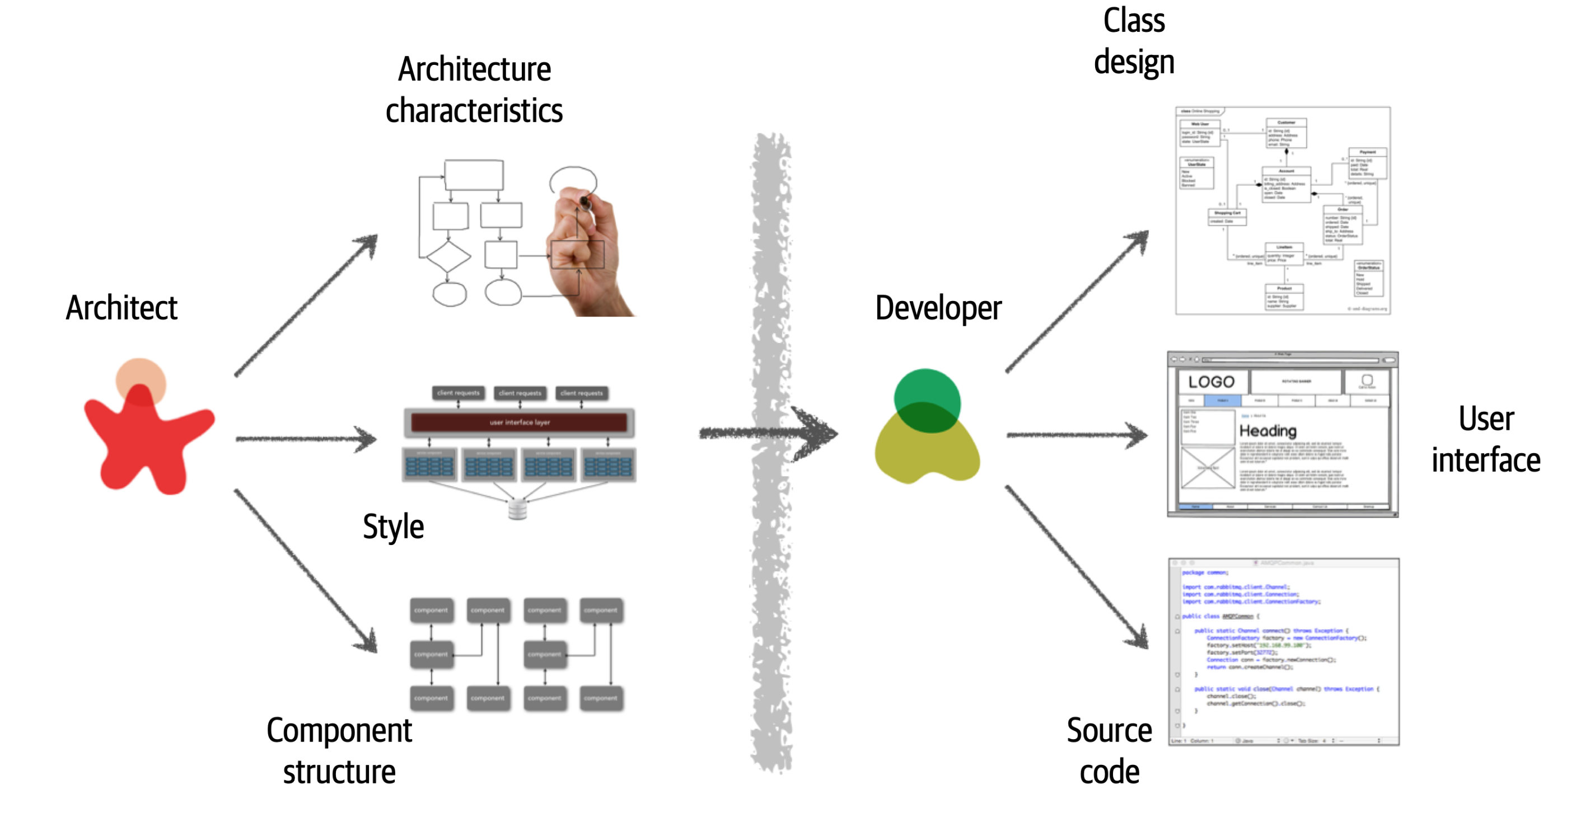
Architecture vs Design
Source: Fundamentals of Software Architecture Book

Slide 43
Architecture vs Design
Architect should bever been disconnected from devs
There should be no barriers between developers and architects
Architect should mentor and coach developers
Developers could take part in architecture decisions as well
Source: Fundamentals of Software Architecture Book

Slide 44
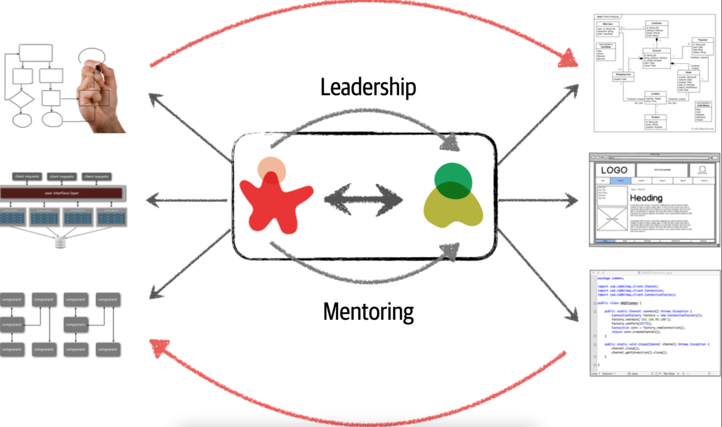
Architecture vs Design
Source: Fundamentals of Software Architecture Book

Slide 45
Analyzing Trade-Offs

Slide 46
Analyzing Trade-Offs
Everything in architecture is a trade-off
Answer to every architecture question in the universe is “it depends.”
Many people get annoyed at this answer, it is unfortunately true.
You cannot Google the answer to whether REST or messaging would be better, or whether microservices is the right architecture style, because it does depend

Slide 47
Understanding Architecture Drivers

Slide 48
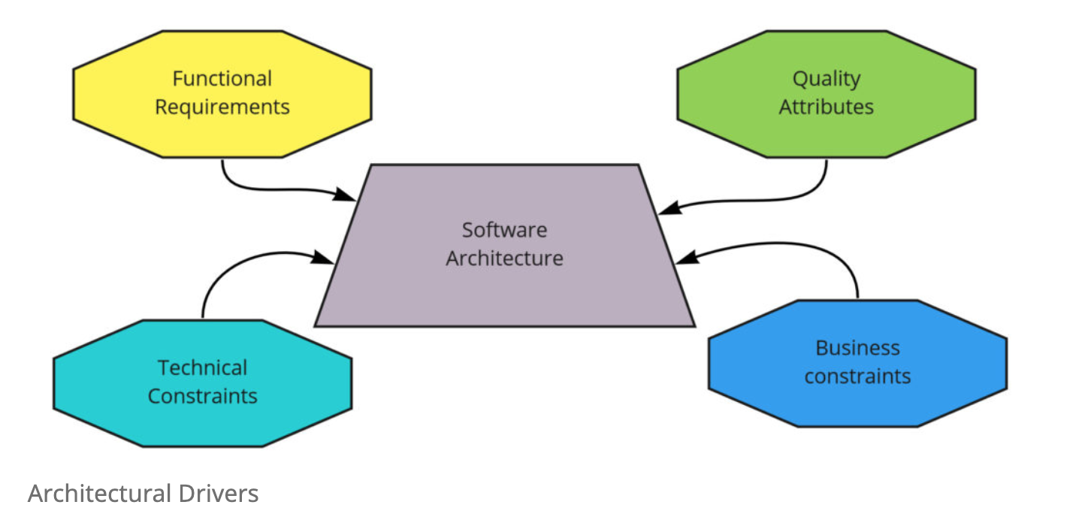
Understanding Architecture Drivers
Source: http://www.kamilgrzybek.com/design/modular-monolith-architectural-drivers/

Slide 49
Understanding Architecture Drivers
Functional Requirements
Quality Attributes – a set of attributes that determine the quality of architecture like maintainability or scalability.
Technical Constraints – technology standards, tools limitations, team experience
Business Constraints – budget, hard deadline

Slide 50
Understanding Architecture Drivers
We often know what is “state of the art” solution, but do we have resources to achieve it?
Analyse the architecture drivers on every decision
Storing data in single file sometimes is enough :)
Kafka is almost always best queue to choose, but:
Do have experts in that field?
Infrastructure?
Ops?

Slide 51
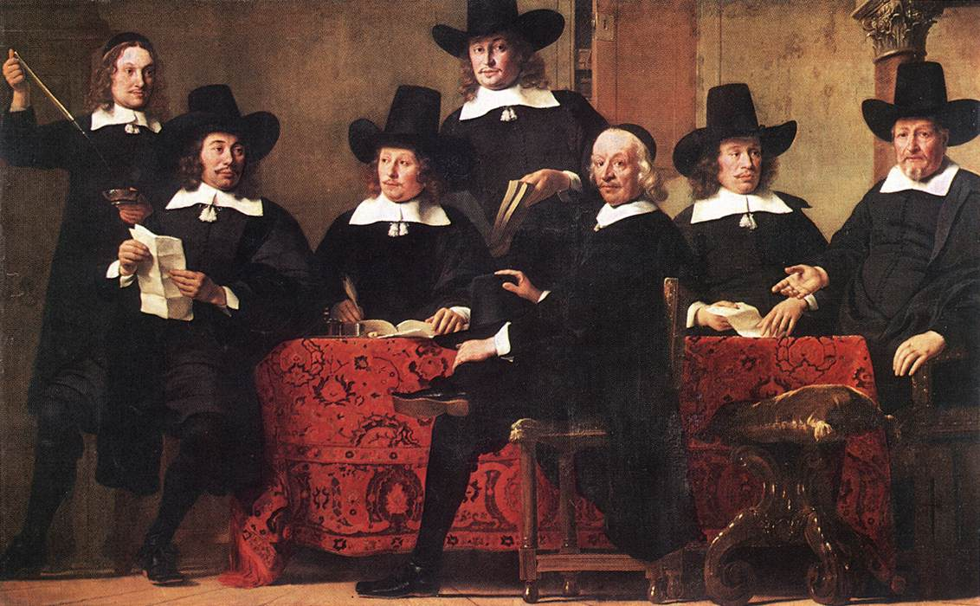
Architecture Guild
Source: https://commons.wikimedia.org/wiki/File:Governors_of_the_Wine_Merchant%27s_Guild.jpg

Slide 52
Do you have architecture guild in your org? How many people is on the call?

Slide 53
Architecture Guild
If you have bigger organization – it’s a must
Try to share the main architect with others
It needs to publish its work to the wider audience
Explore the problems within the guild
Communicate the decisions to the developers
Let developers have idea what’s happening on the meeting
Use RFC template
Store all the decisions
Let developers comment all the RFC

Slide 54
Architecture Guild
RFC = request for comments
Big orgs uses that
IETF
Mozilla
Golang
Many others
Create a repo with all RFCs
RFC template:
https://github.com/tensorflow/community/blob/master/rfcs/yyyymmdd-rfc-template.md

Slide 55

Architecture Visualization

Slide 56
Break 13:10

Slide 57
Architecture Visualization
Who is using UML?
BPMN?

Slide 58
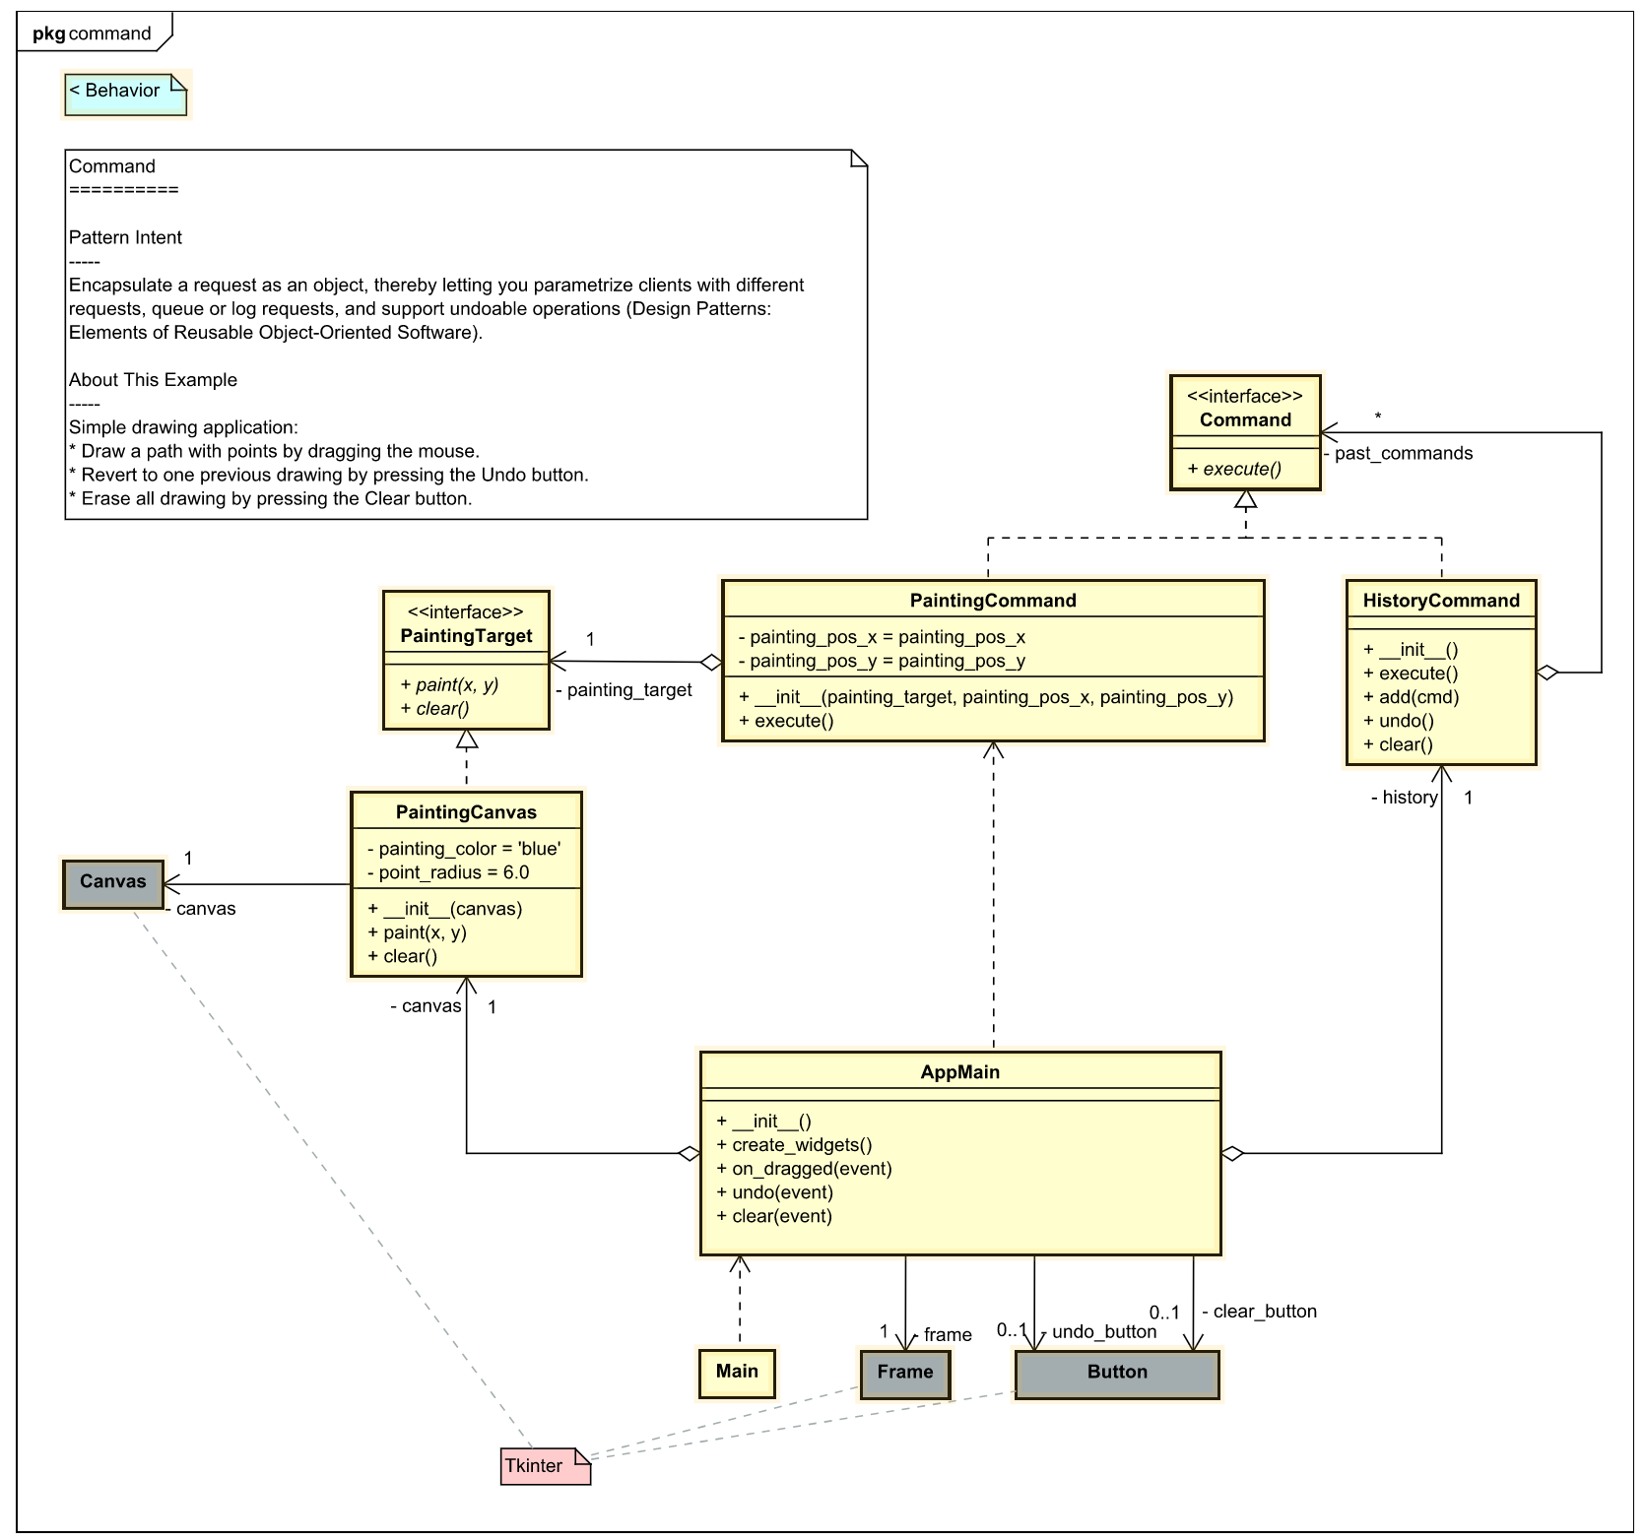
UML
Source: https://dev.to/takaakit/uml-diagram-for-gof-design-pattern-examples-in-python-4j40

Slide 59
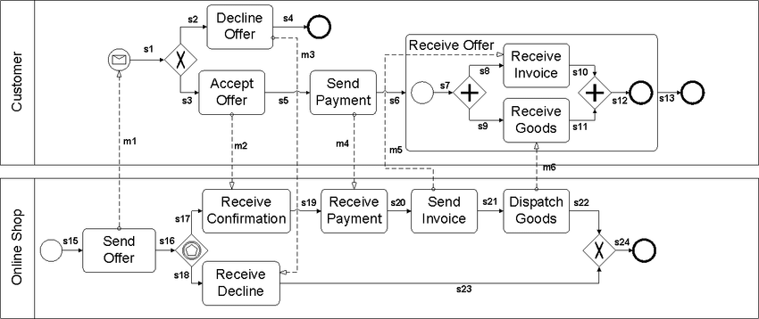
BPMN
Source: https://www.researchgate.net/figure/A-running-example-of-a-BPMN-diagram_fig3_295135730

Slide 60
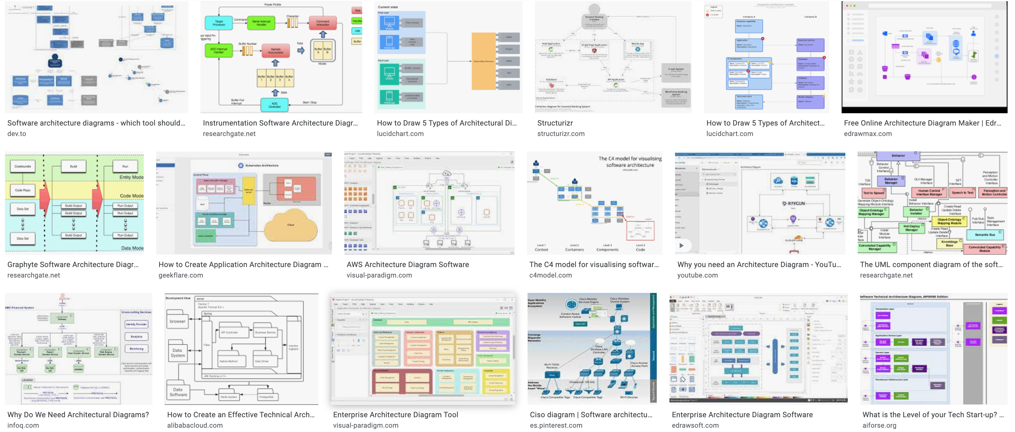
Show me your architecture
Source: https://www.google.com/search?q=software+architecture+diagram

Slide 61
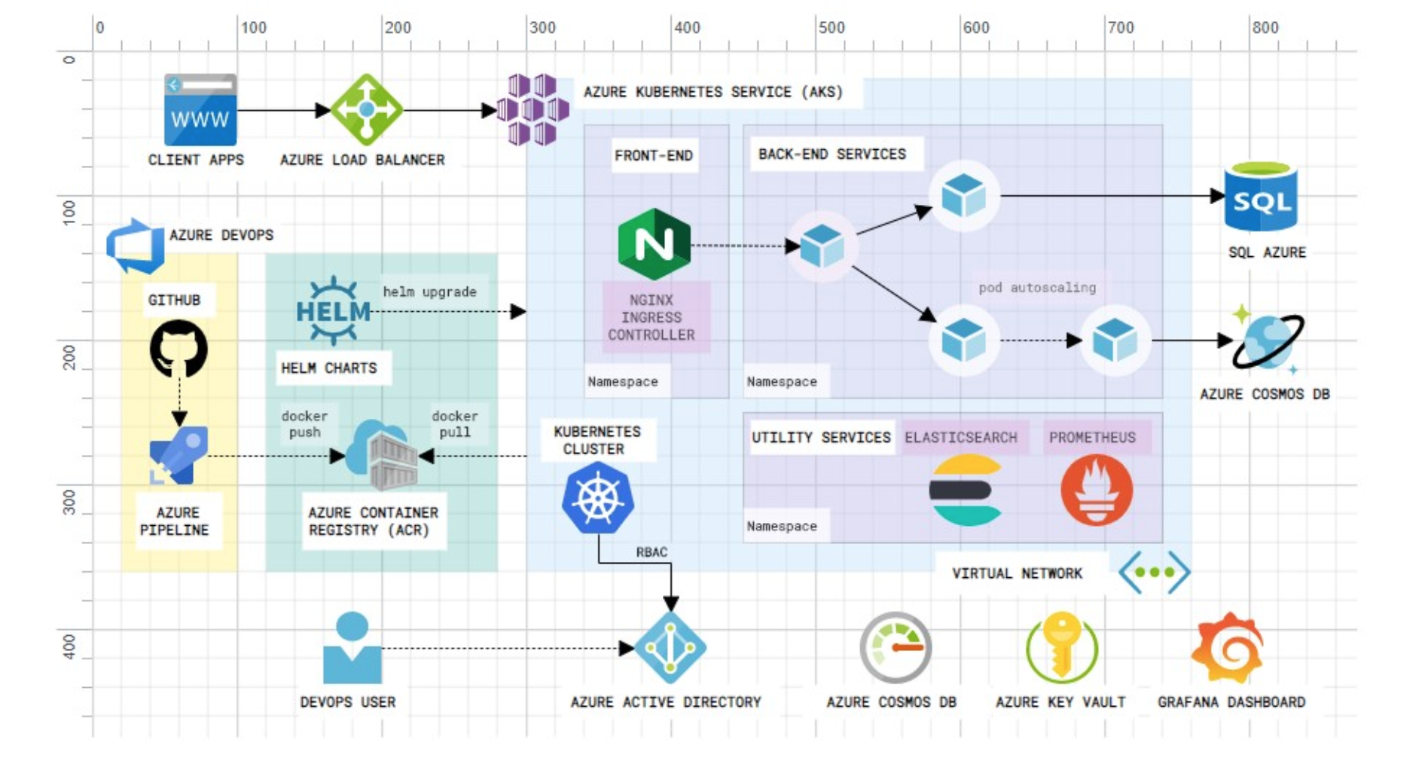
Show me your architecture
Source: https://github.com/cloudskew/cloudskew

Slide 62
Architecture Visualization
It’s Infrastructure!
I have no idea what does system do
Mostly tech stack graphics

Slide 63
Architecture Visualization
Component Level Architecture
Usually there is no diagram but architect can draw it
So…

Slide 64
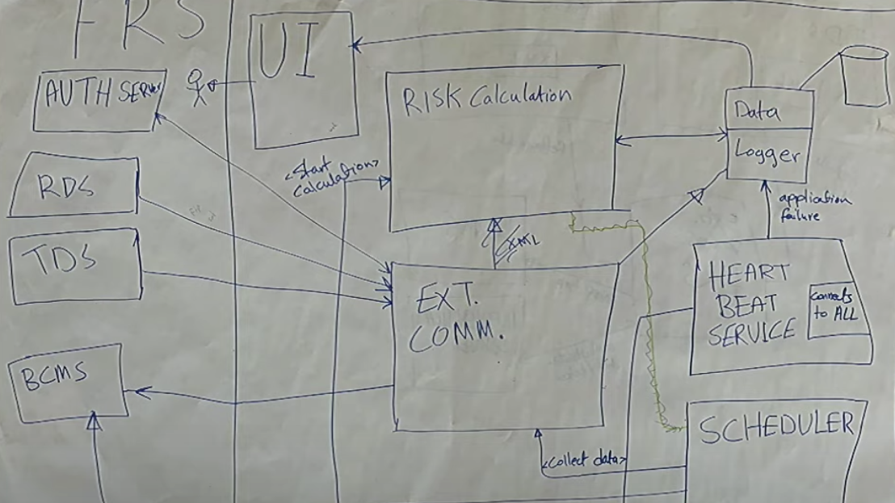
Source: Visualising software architecture with the C4 model - Simon Brown https://www.youtube.com/watch?v=x2-rSnhpw0g

Slide 65
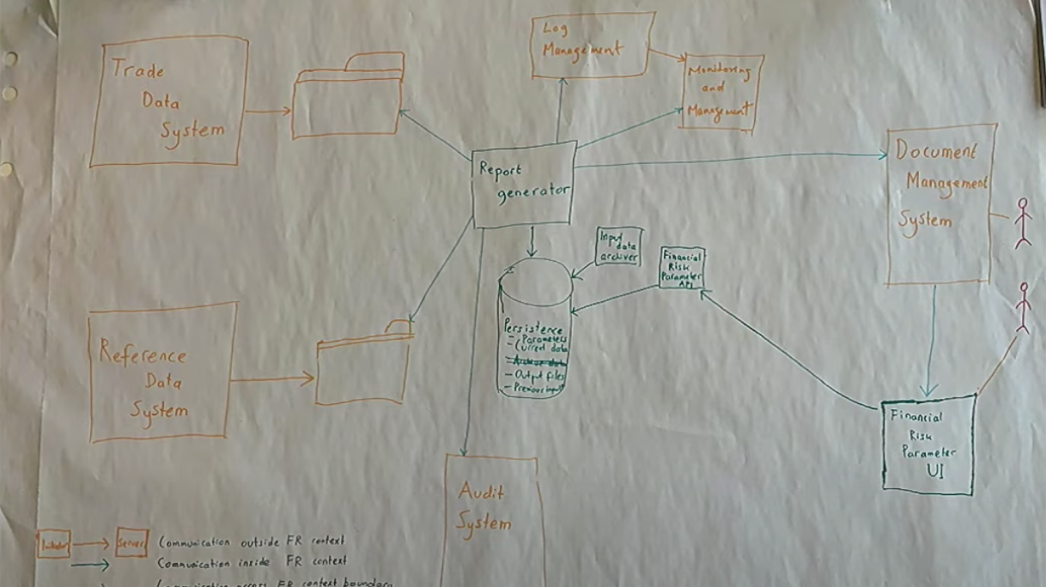
Source: Visualising software architecture with the C4 model - Simon Brown https://www.youtube.com/watch?v=x2-rSnhpw0g

Slide 66
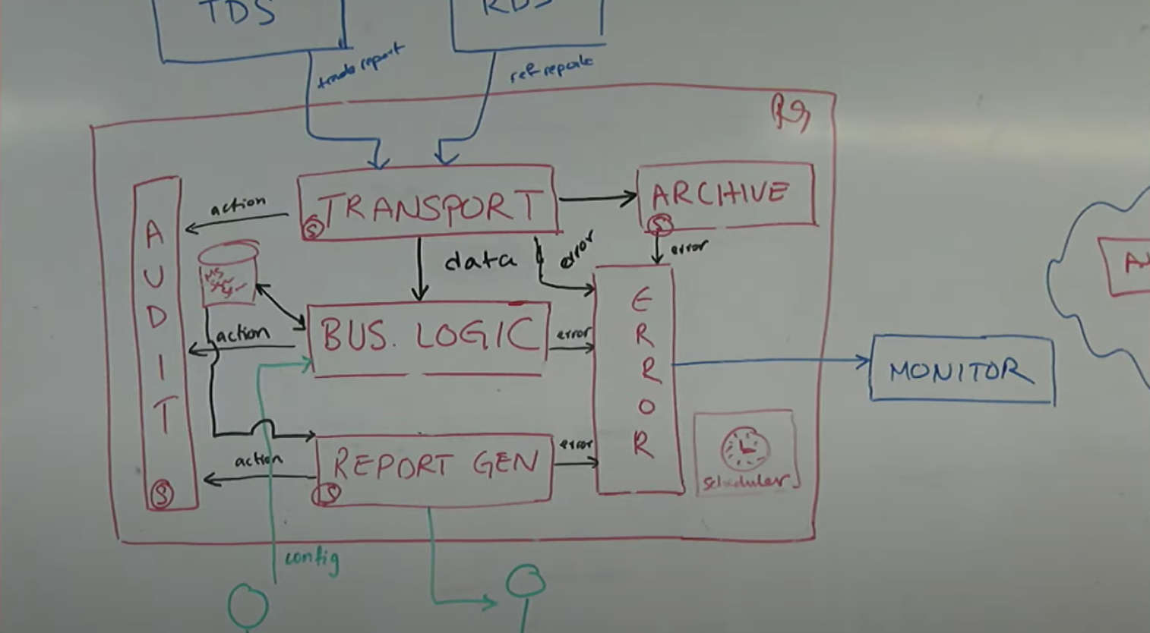
Source: Visualising software architecture with the C4 model - Simon Brown https://www.youtube.com/watch?v=x2-rSnhpw0g

Slide 67
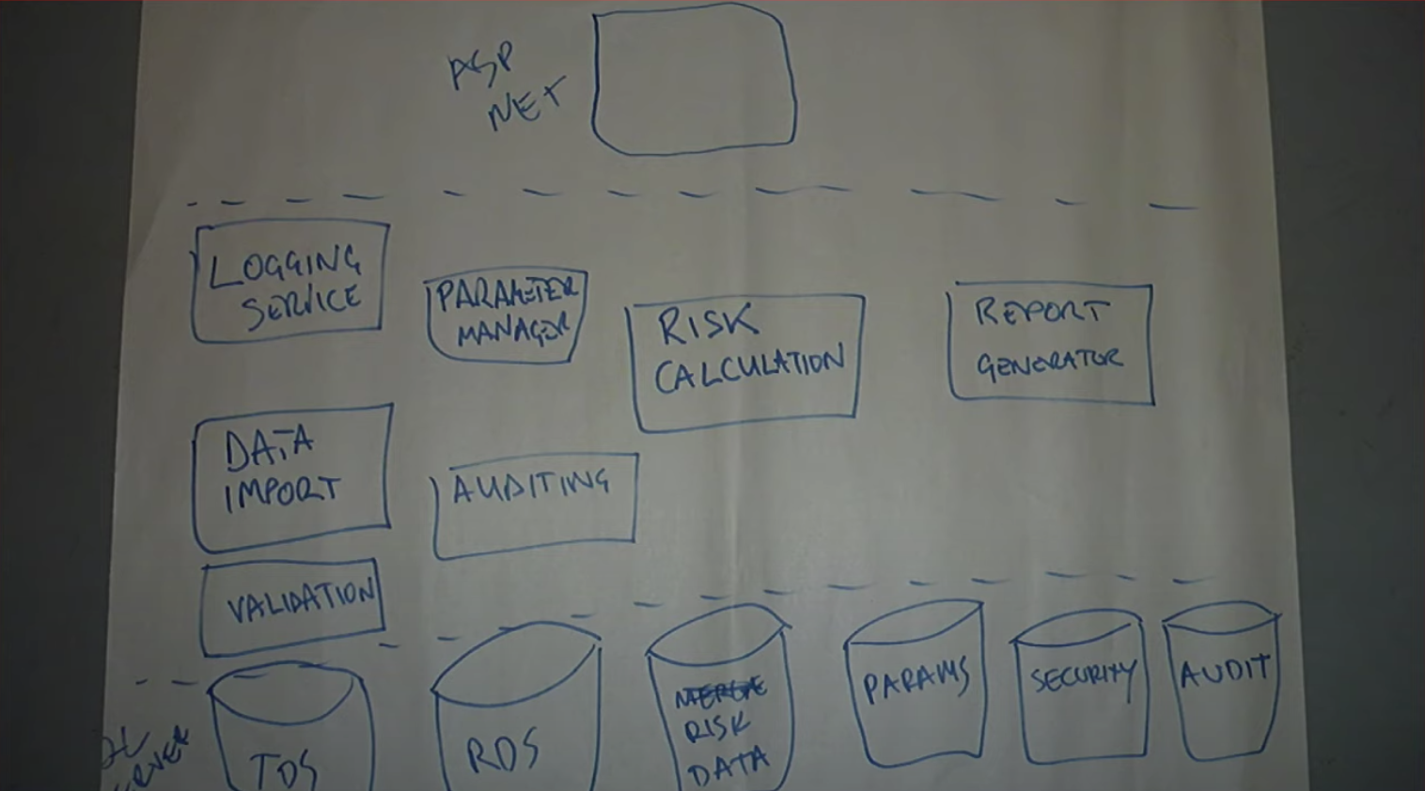
Source: Visualising software architecture with the C4 model - Simon Brown https://www.youtube.com/watch?v=x2-rSnhpw0g

Slide 68
Software Architecture
Random colours
Random shapes
No lines
No arrows
Think about civil engineers build buildings based on such plans

Slide 69
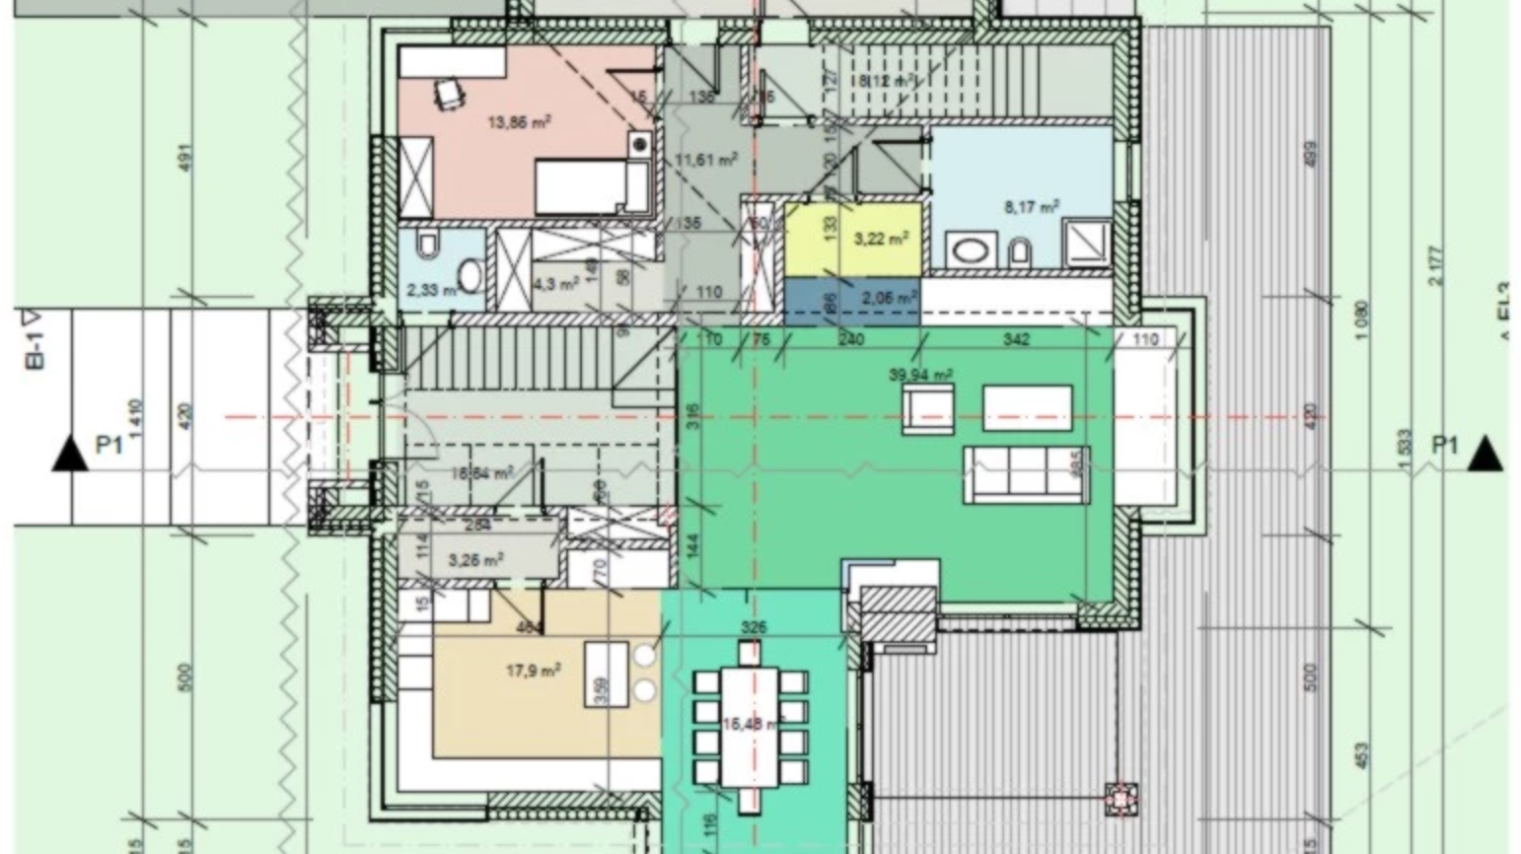
Imagine that someone is building your house based on such plans
Source: https://www.homebook.pl/inspiracje/styl-tradycyjny?fpid=848205#itemid=848205

Slide 70
C4 Model

Slide 71
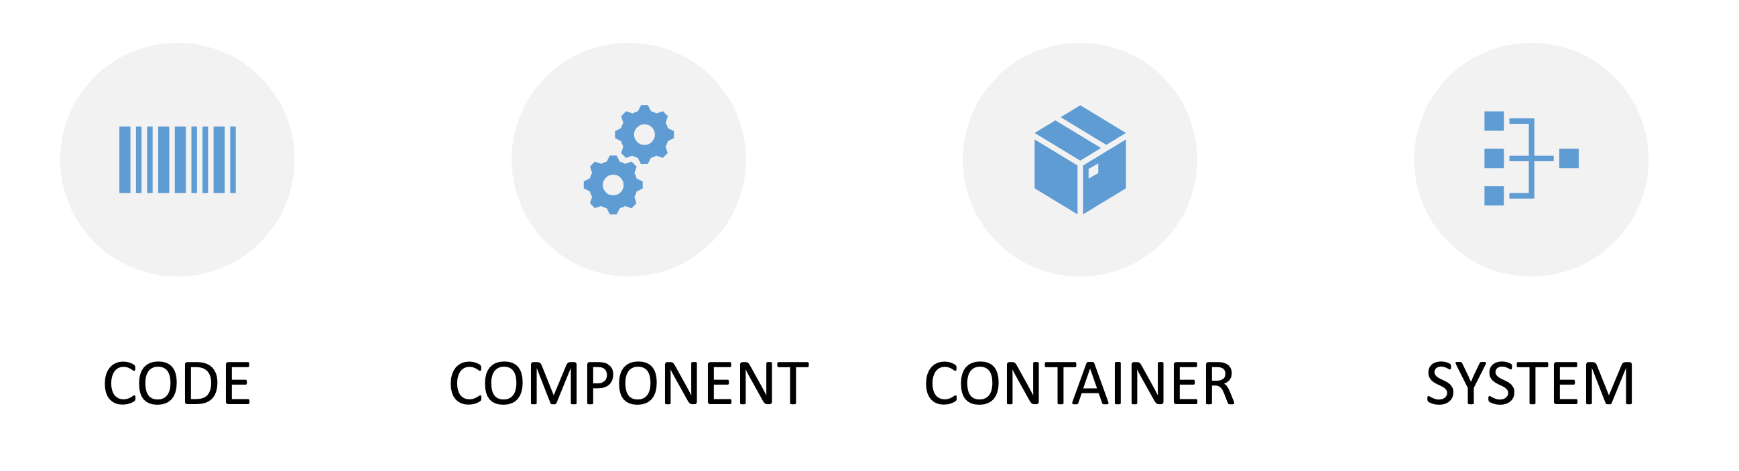
C4 Model
Source: https://c4model.com/

Slide 72
C4 Model
The C4 model was inspired by the UML and the 4+1 model for software architecture.
C4 model as a simplified version of the underlying concepts designed to
make it easier for software developers to describe and understand how a software system works
to minimise the gap between the software architecture model/description and the source code.
Source: https://c4model.com/

Slide 73
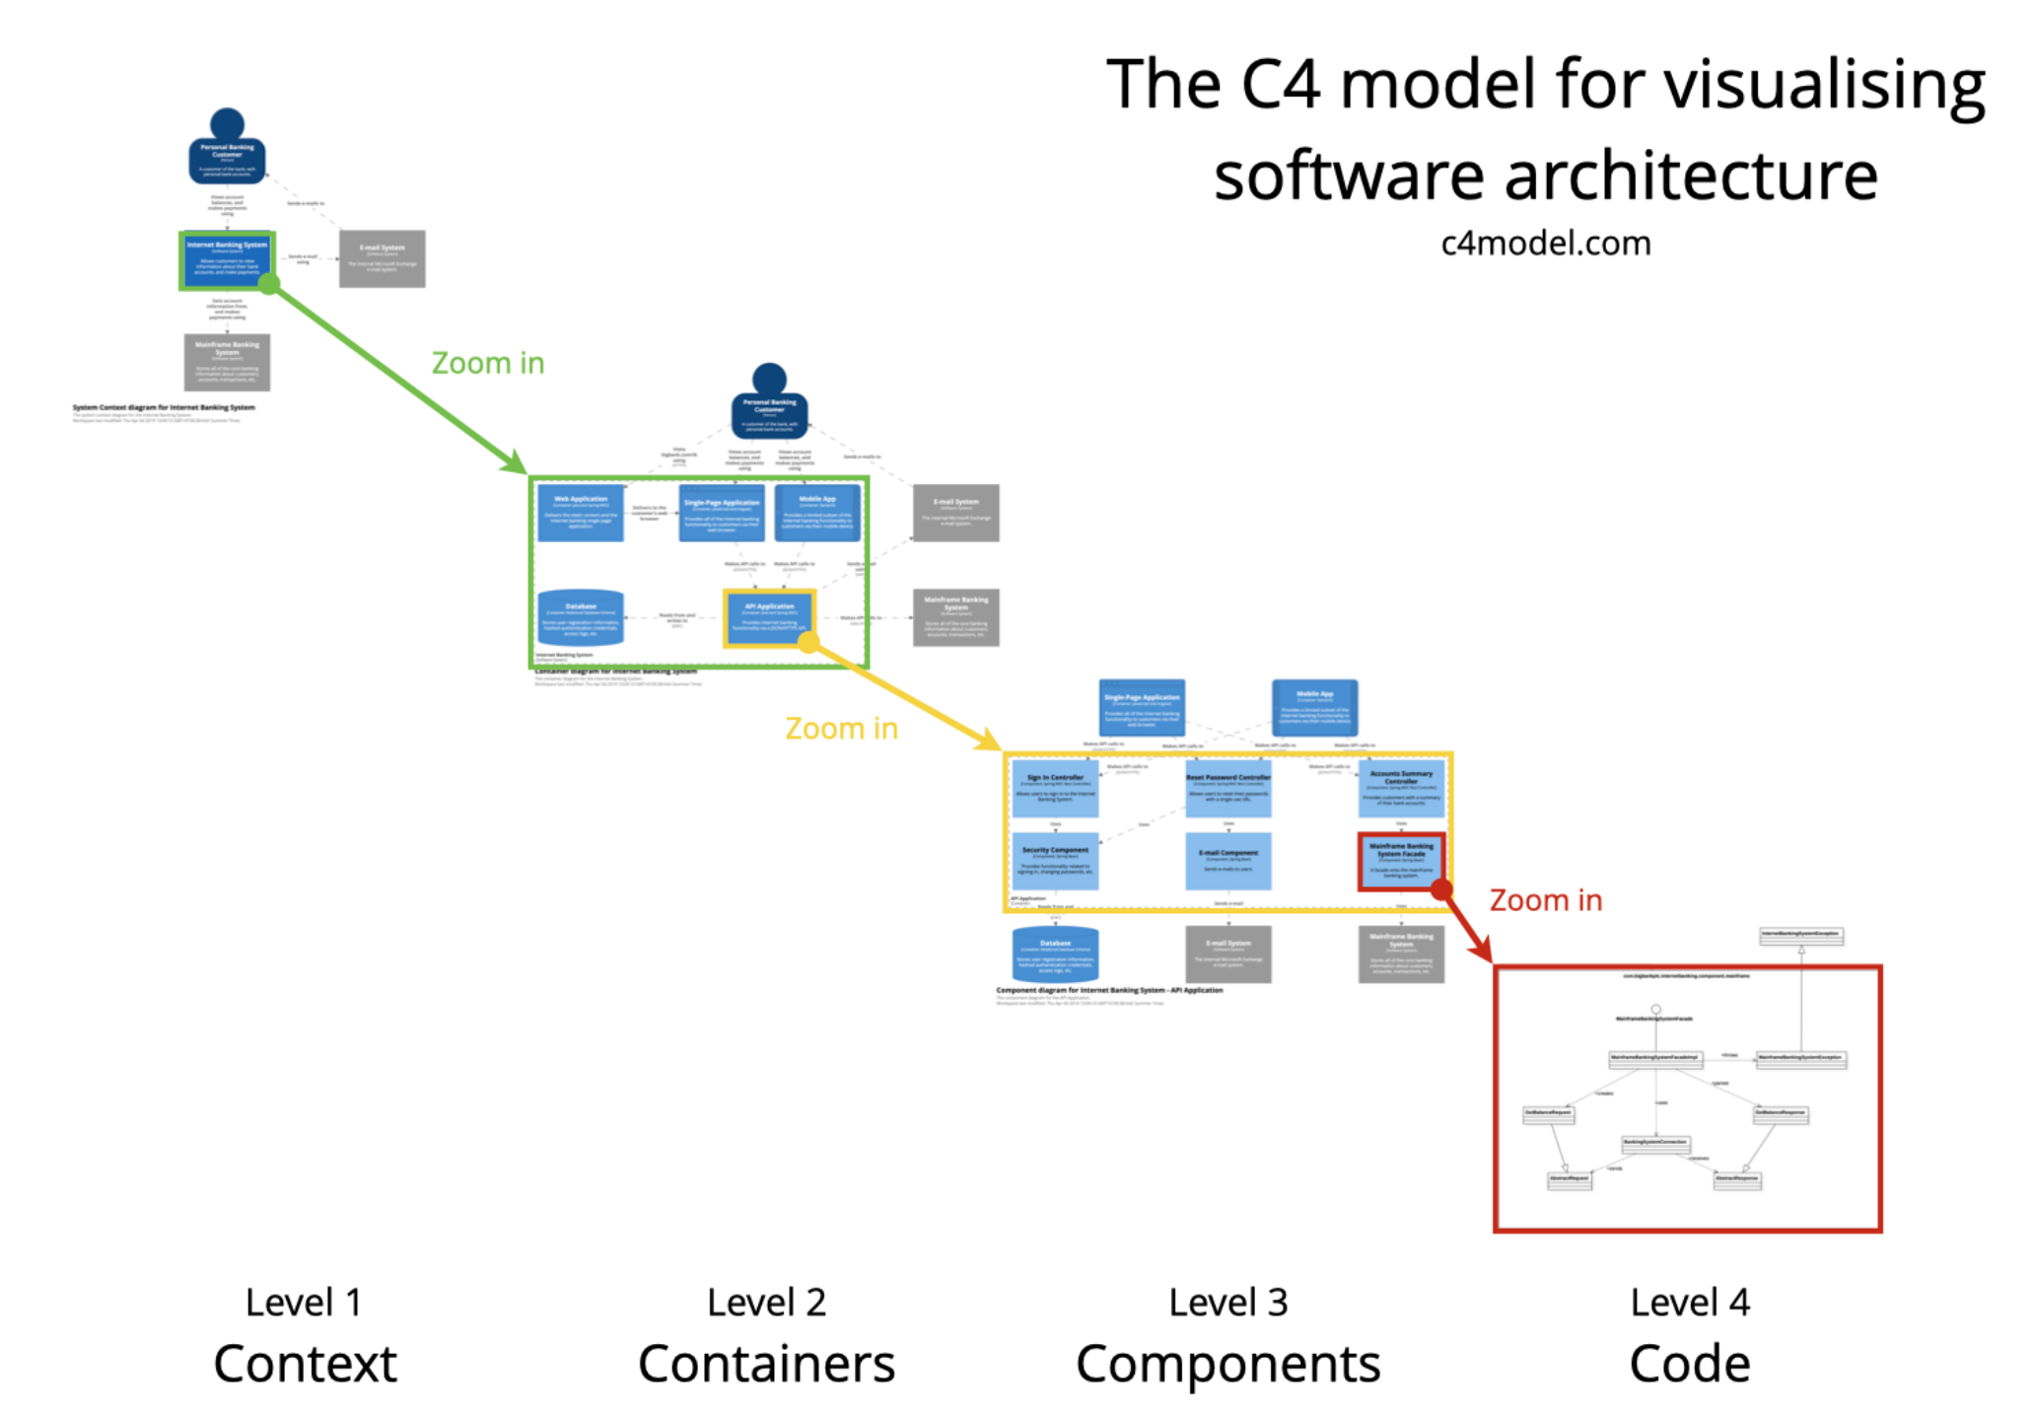
Source: https://c4model.com/

Slide 74
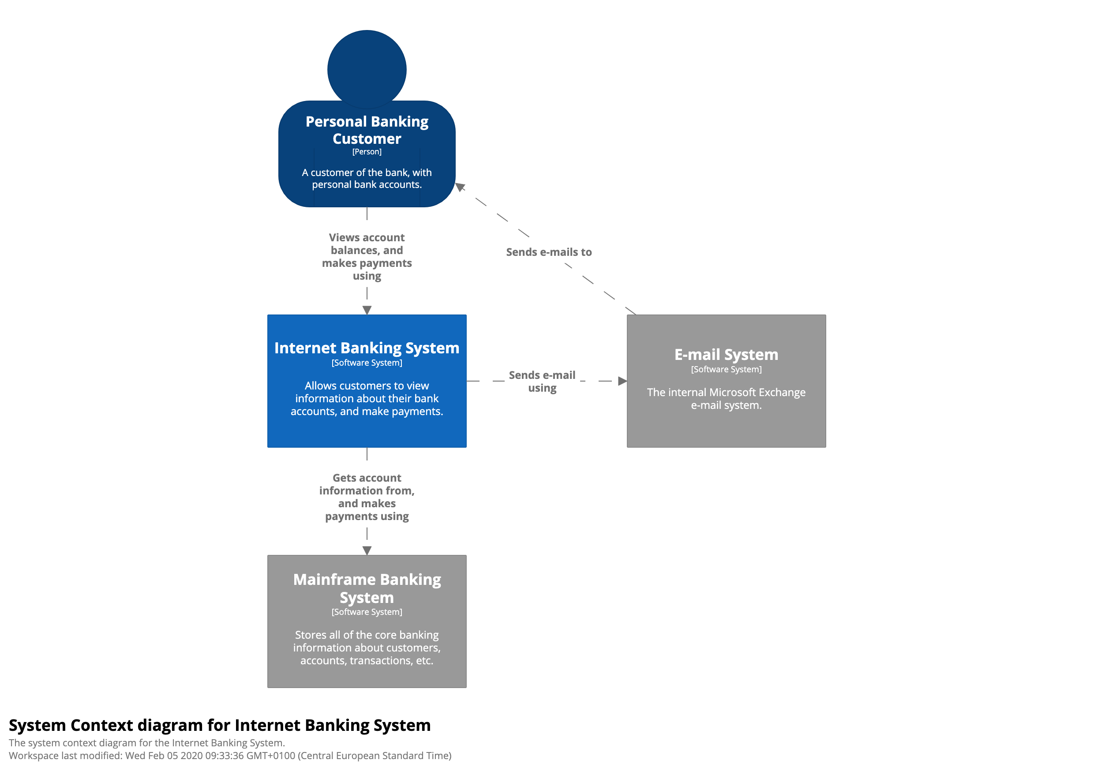
Context
Source: https://c4model.com/

Slide 75
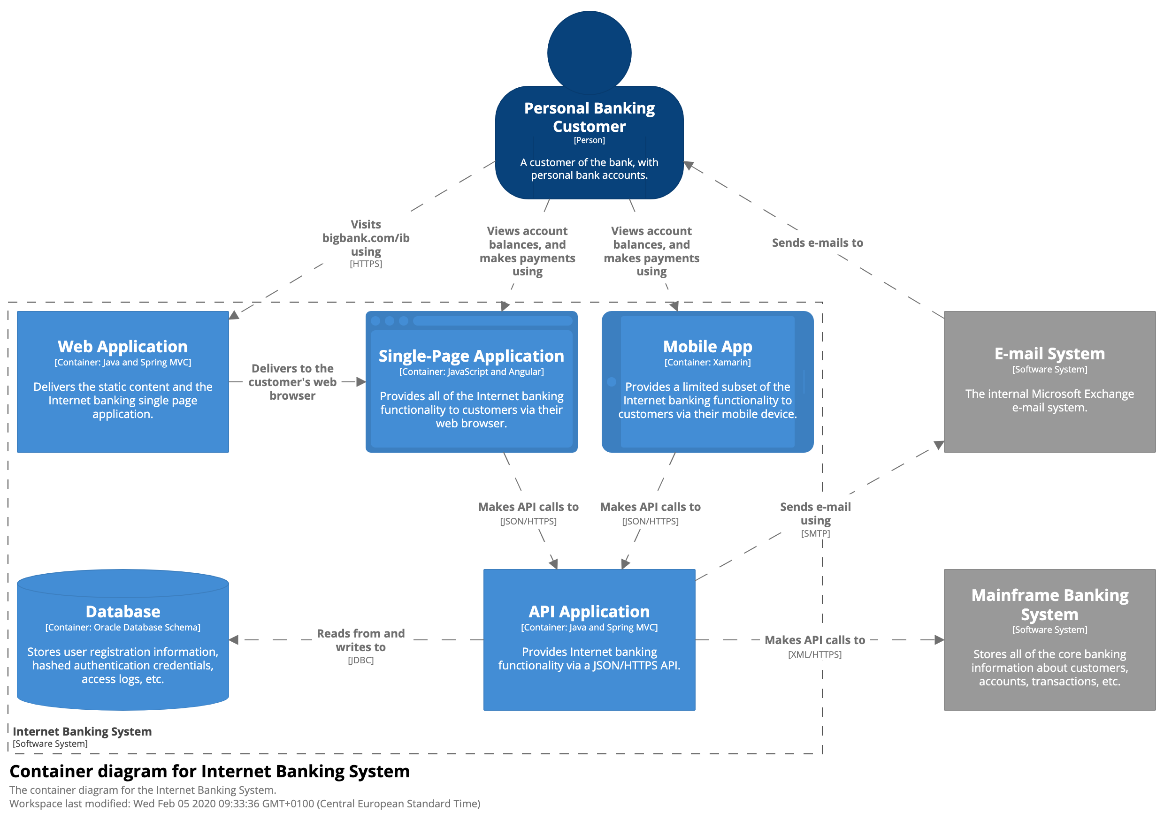
Component
Source: https://c4model.com/

Slide 76
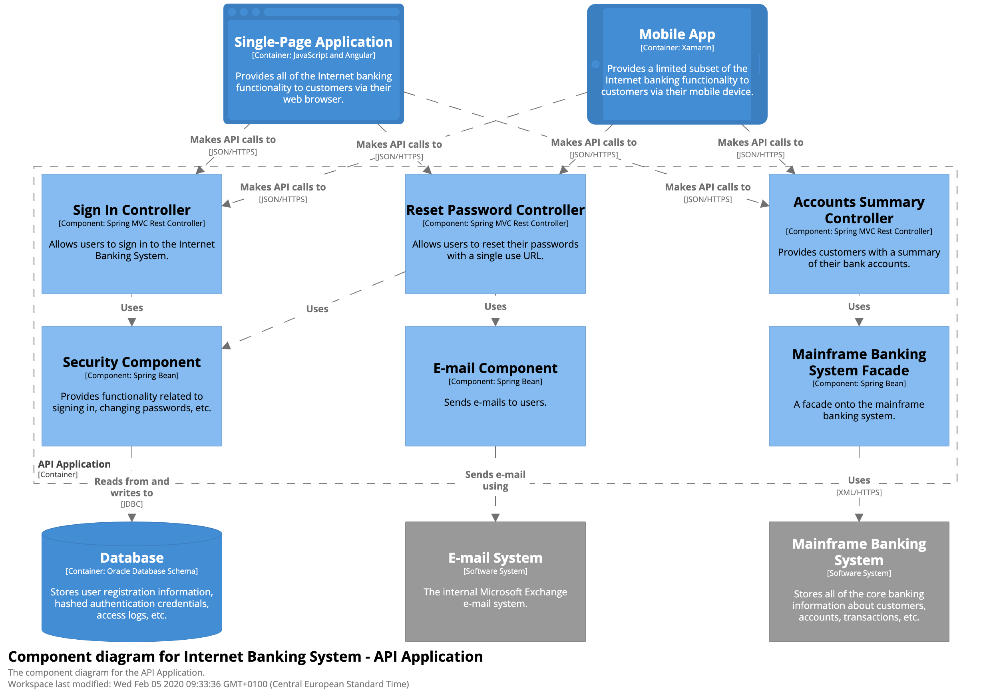
Container
Source: https://c4model.com/

Slide 77
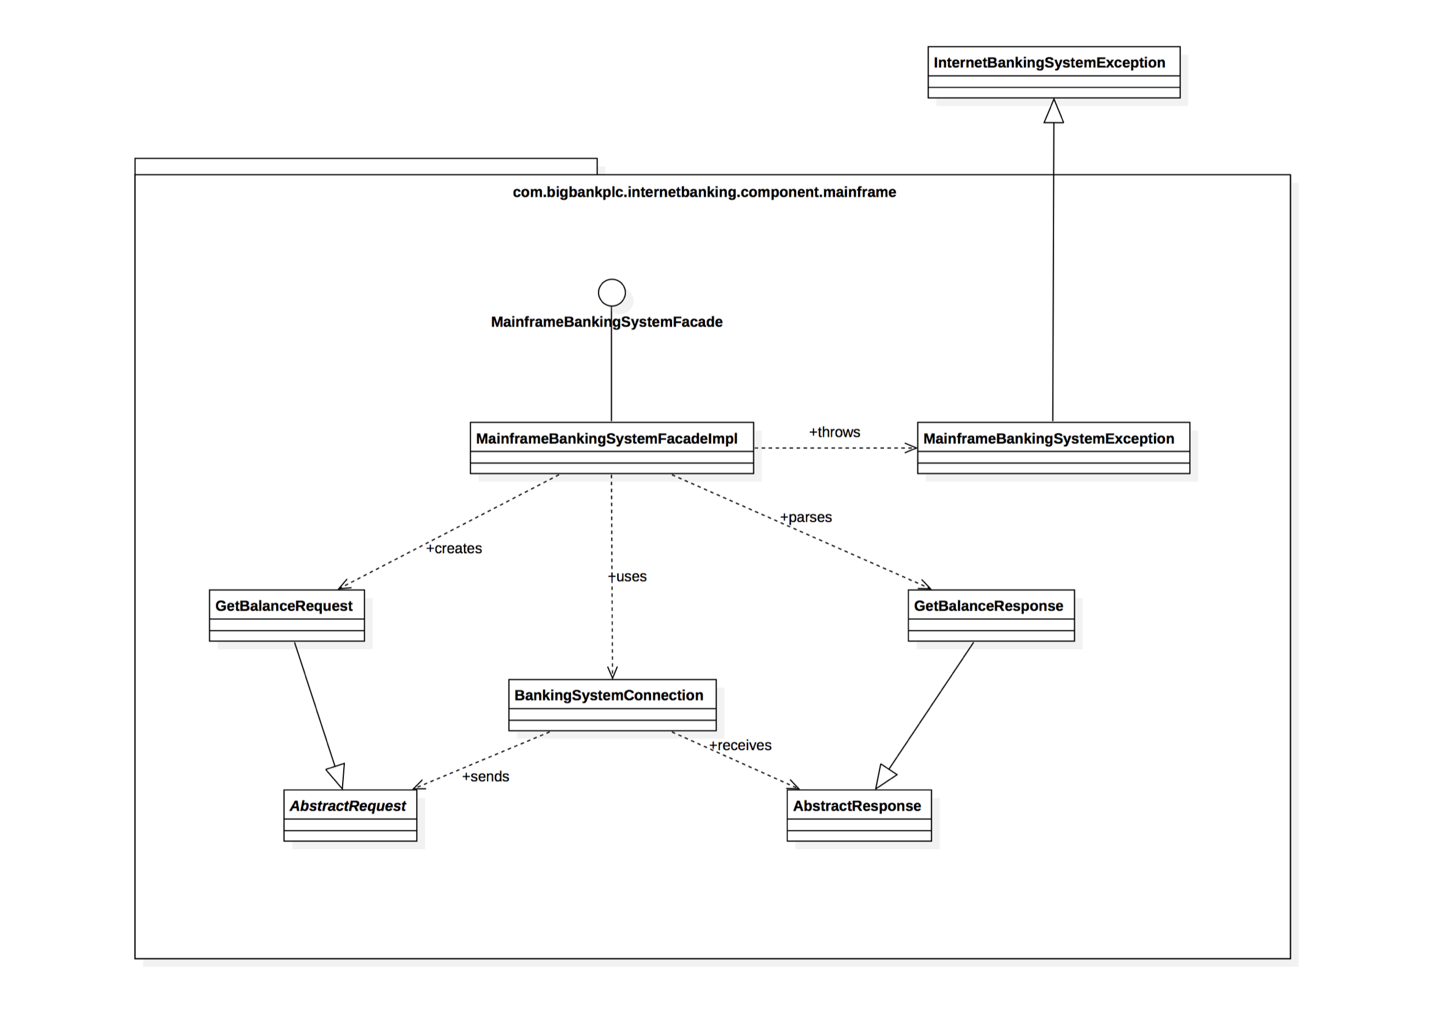
Code
Source: https://c4model.com/

Slide 78
C4 model - resources
Archi on-prem
Draw.io plugin - https://github.com/tobiashochguertel/c4-draw.io
More: https://c4model.com/
VSCode plugin - https://marketplace.visualstudio.com/items?itemName=systemticks.c4-dsl-extension
Good example: https://github.com/kgrzybek/modular-monolith-with-ddd#30-c4-model
Must see: https://www.youtube.com/watch?v=x2-rSnhpw0g

Slide 79
C4 model - summary
Organize Architecture visualization nicely
Zoom-in <–> zoom-out approach
Good support in IDEs
Possibility to generate “code diagram” from code
Highly recommended

Slide 80

Architecture Metrics

Slide 81
Who of you use architecture metrics? Which one?

Slide 82
Architecture metrics
Code perspective:
Component size (number of statements)
Coupling
Cohesion
Complexity(cyclomatic complexity)

Slide 83
Architecture metrics
But Managers love
Bugs/incidents
Time/Cost of implementing new feature
Deployment frequency
Security incidents
Team velocity
Cost of infrastructure
Test coverage

Slide 84
Architecture metrics
Performance metrics
Response time
Throughput
Up-time
Requests per second
CPU usage, latency, battery usage, data consumption, memory usage

Slide 85
Architecture metrics
My advice:
Remove technical debt – but remember about YAGNI
Technical Debt = Cyclic dependencies and coupling
Time of implementing new feature
Maybe it’s time to refactor?
Fitness function

Slide 86
Key Software Development Concepts

Slide 87
SOLID
The Single-responsibility principle – every module, class or function should have responsibility over a single part of that program's functionality, and it should encapsulate that part
The Open–closed principle - Software entities ... should be open for extension, but closed for modification
The Liskov substitution principle - enables you to replace objects of a parent class with objects of a subclass without breaking the application
The Interface segregation principle - Many client-specific interfaces are better than one general-purpose interface
The Dependency inversion principle - Depend upon abstractions, [not] concretions

Slide 88
DRY
Do not repeat yourself
Automate everything

Slide 89
KISS
KISS, an acronym for keep it simple, stupid
a design principle noted by the U.S. Navy in 1960
KISS principle states that most systems work best if they are kept simple rather than made complicated
simplicity should be a key goal in design

Slide 90
YAGNI
You aren't gonna need it
Probably the most important from Architecture perspective
YAGNI is a principle behind the XP practice of "do the simplest thing that could possibly work" (DTSTTCPW)
Used without continuous refactoring - lead to technical debt

Slide 91
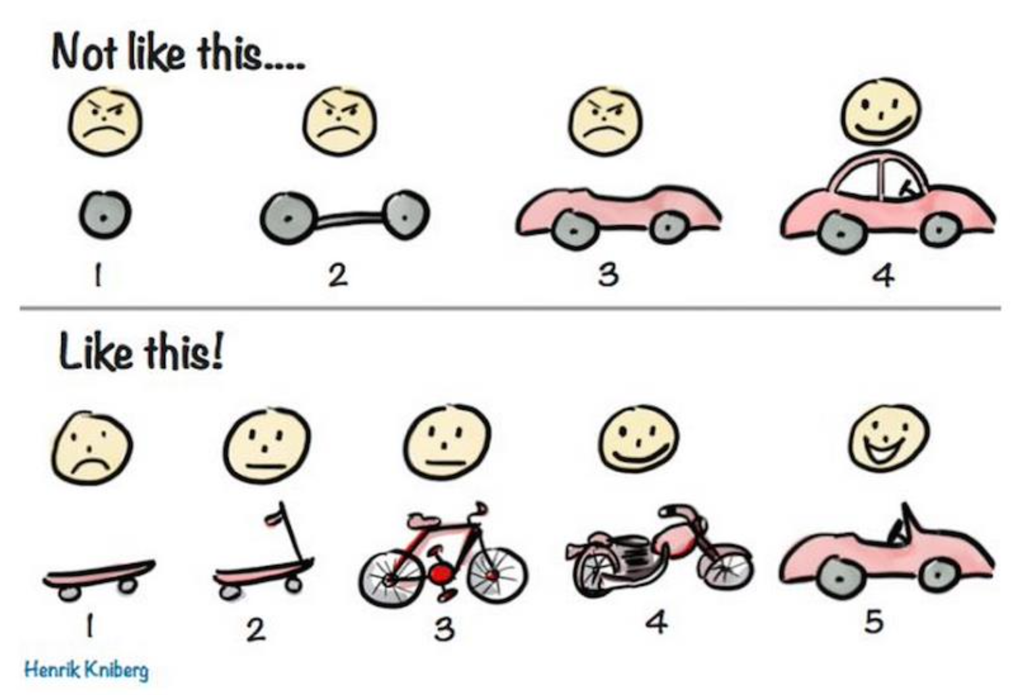
Use Agile metodology

Slide 92
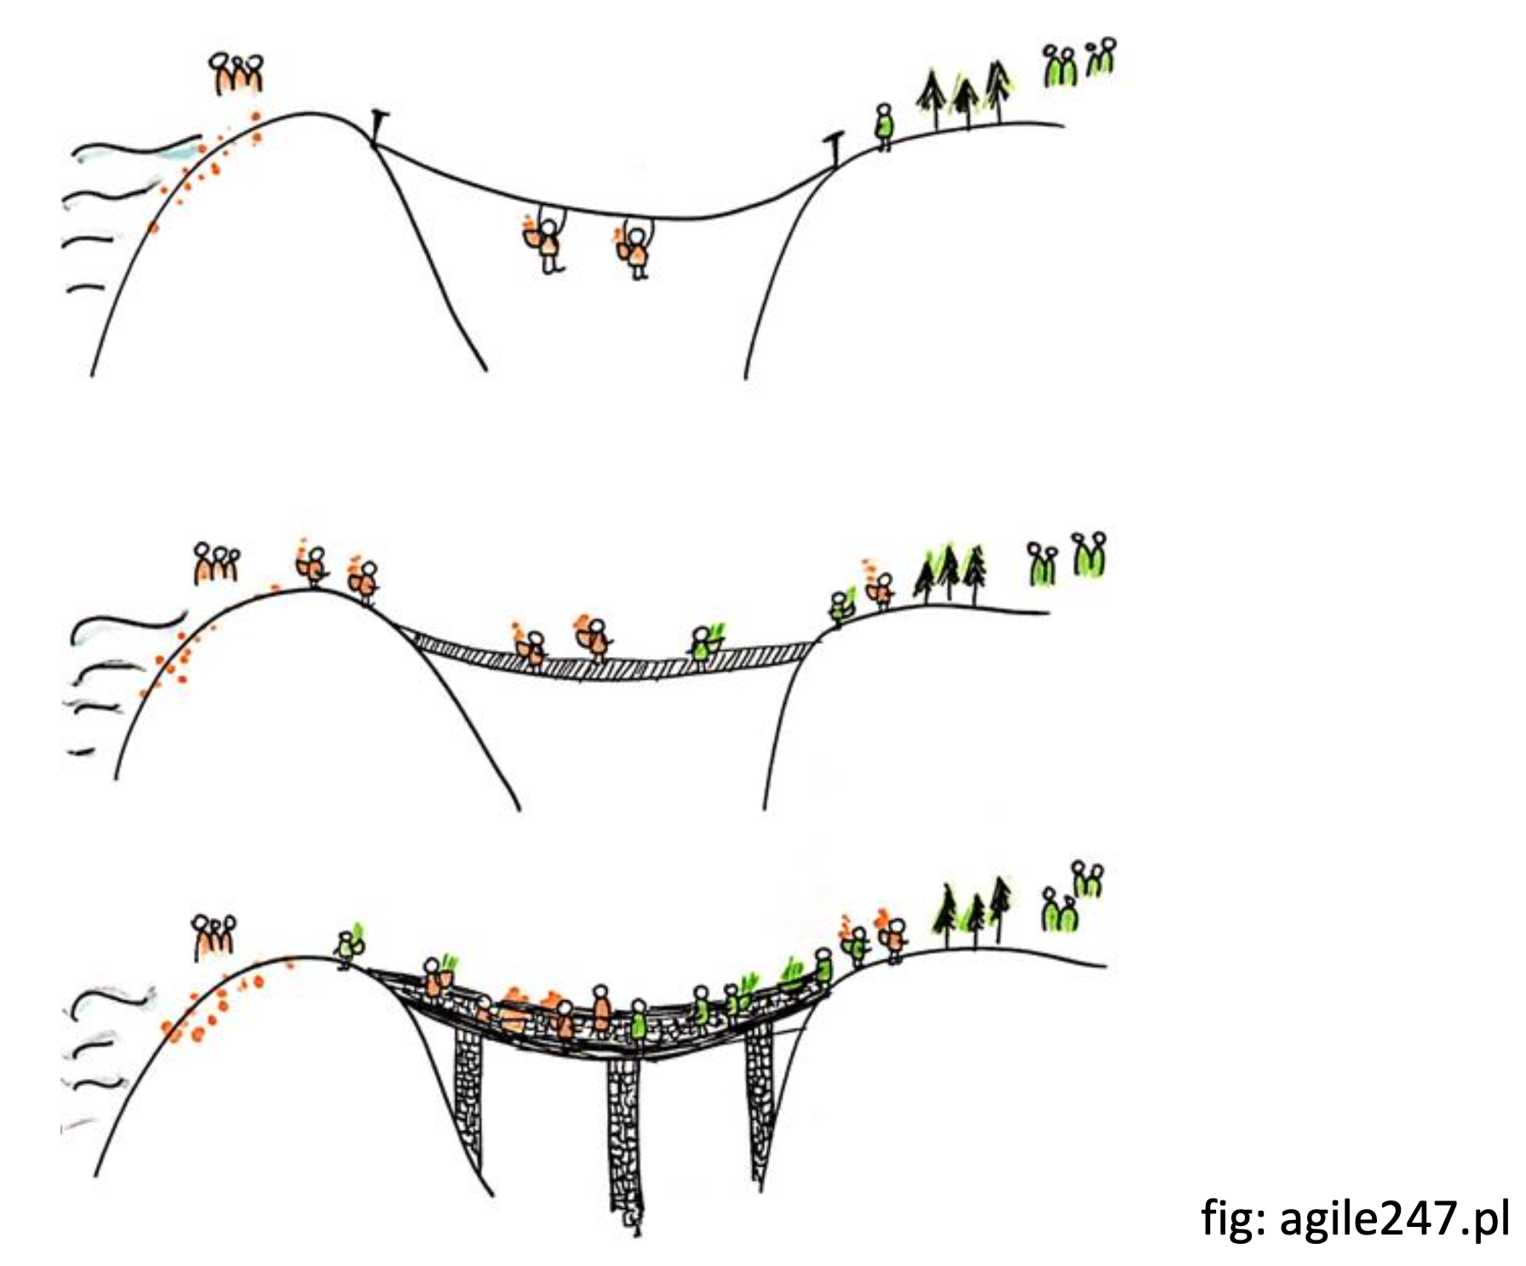
Use Agile metodology

Slide 93

Domain Driven Design

Slide 94
“The most critical complexity of most software projects is understanding the business domain itself” - Eric Evans

Slide 95
Domain Driven Design
Initially introduced and made popular by programmer Eric Evans in his 2004 book, Domain-Driven Design: Tackling Complexity in the Heart of Software
To define domain-driven design we should first establish what we mean by domain in this context
Domain is the “sphere of knowledge and activity around which the application logic revolves.”

Slide 96
DDD
DDD focuses on three core principles:
Focus on the core domain and domain logic.
Base complex designs on models of the domain.
Constantly collaborate with domain experts, in order to improve the application model and resolve any emerging domain-related issues.

Slide 97
DDD
DDD concepts:
Context: The setting in which a word or statement appears that determines its meaning. Statements about a model can only be understood in a context.
Model: A system of abstractions that describes selected aspects of a domain and can be used to solve problems related to that domain.
Ubiquitous Language: A language structured around the domain model and used by all team members to connect all the activities of the team with the software.
Bounded Context: A description of a boundary (typically a subsystem, or the work of a specific team) within which a particular model is defined and applicable.

Slide 98
DDD – building blocks
Entity
Value Object
Domain Event
Aggregate
Service
Repositories
Factories

Slide 99
DDD pros
Eases Communication
establishing ubiquitous language related to the domain model
Improves Flexibility
everything within the domain model will be based on an object and will, therefore, be quite modular and encapsulated
Emphasizes Domain Over Interface
Since DDD is building around the concepts of domain and what the domain experts within the project advise, DDD will often produce applications that are accurately suited

Slide 100
DDD cons
Requires Robust Domain Expertise
Encourages Iterative Practices
Weak for Highly Technical Projects
Quite slow at the beginning

Slide 101
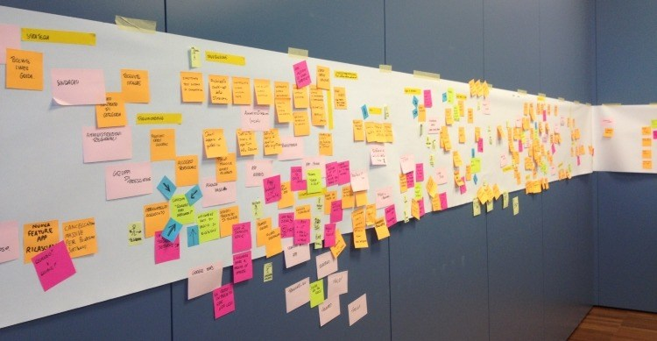
Event Storming
Source: https://ucgosu.pl/2019/04/event-storming/

Slide 102
Event Storming – Mechanics of the workshop
Invite people for the workshop
Provide the place and equipment
Endless walls, whiteboards
Stickers, Markers
Model a whole business line with Domain Events

Slide 103
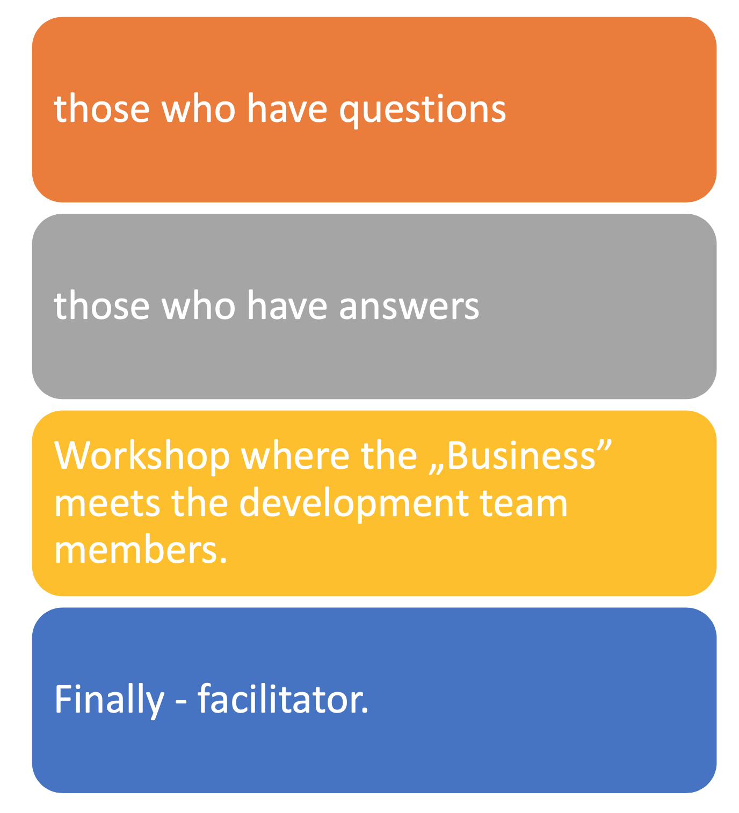
Who’s invited?

Slide 104
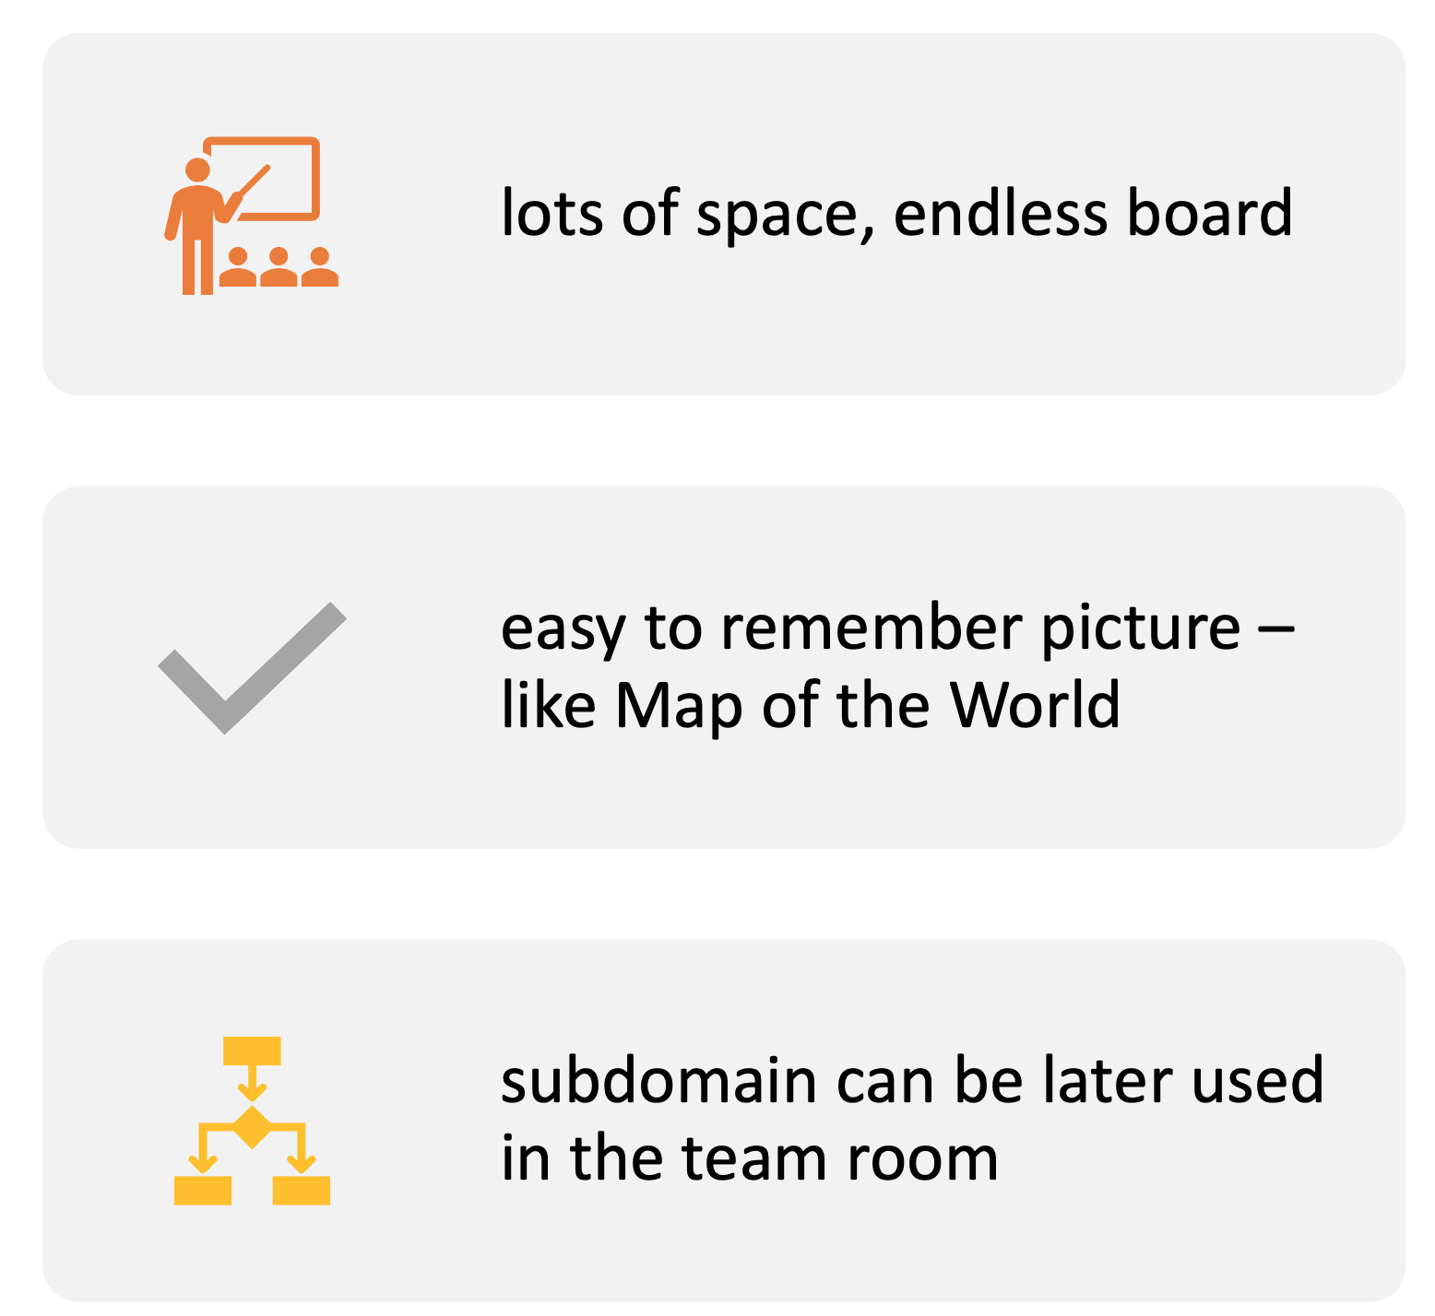
The Place

Slide 105
How does it look like?

Slide 106
Notation

Slide 107

Business fact
Passive form
Examples:
Product is chosen
Money transferred
Email sent

Slide 108
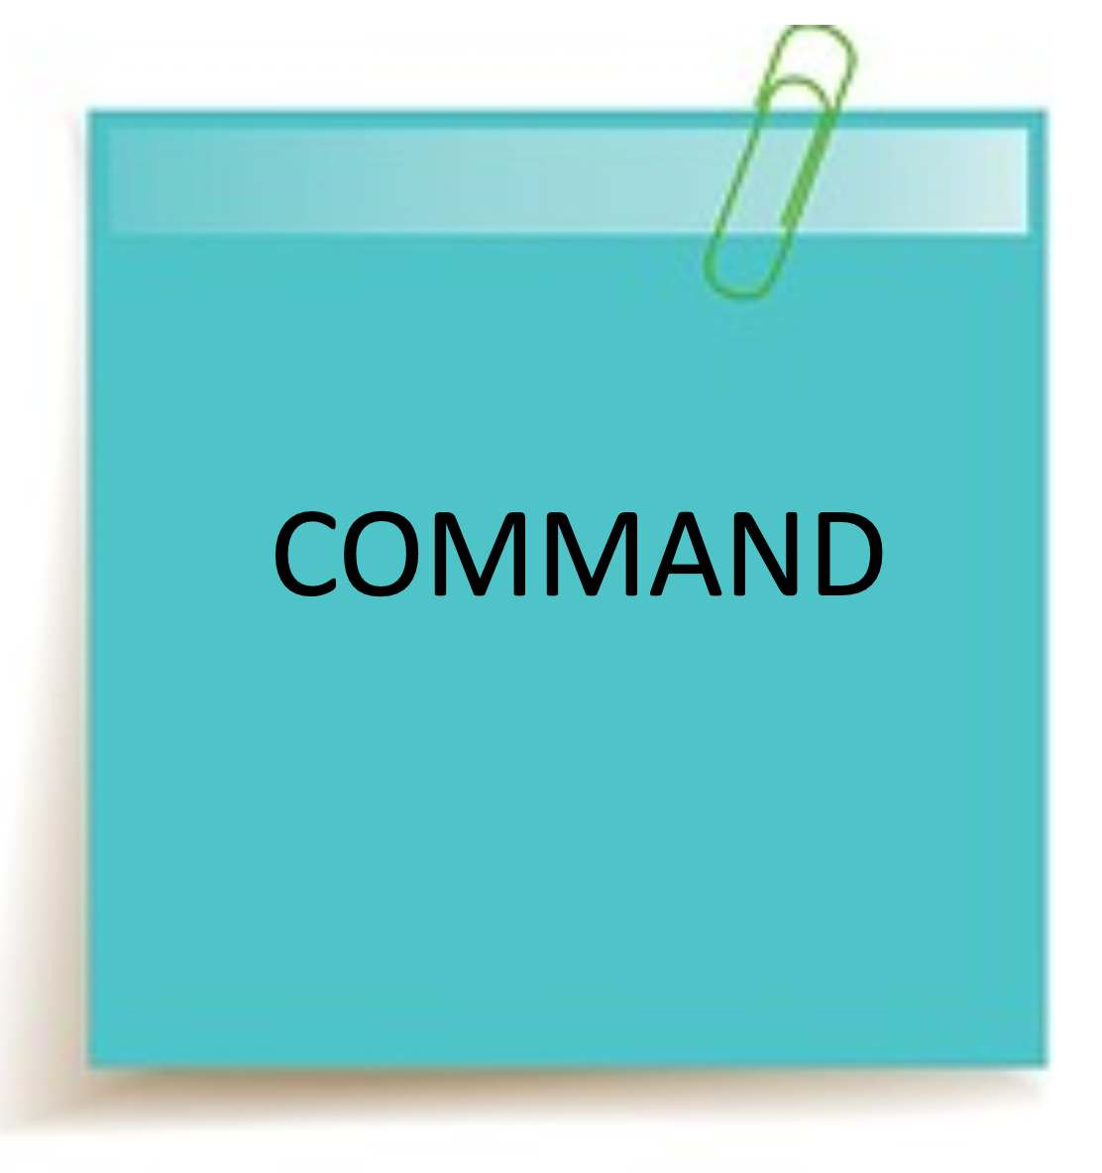
Actors’ or systems’ action
Imperative form
Examples:
Add to list...
Pay for...
Send...

Slide 109
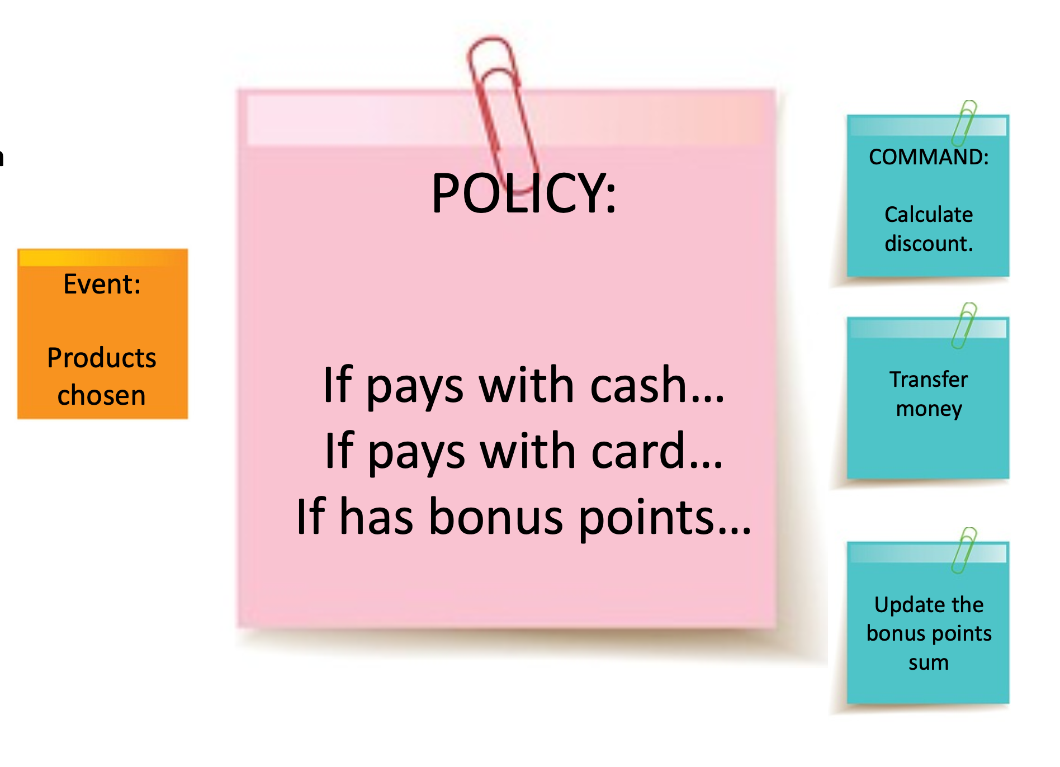
Policy – business rules („if’y”)
Any time <Event> if, then ...<action/commnad>
POLICY:
If pays with cash...
If pays with card... If has bonus points...
COMMAND:
Calculate discount.
Transfer money
Examples:
Event: Products chosen. If cash available: Pay with cash. Else: pay with card.
If has bonus points: Give discount

Slide 110

„Read model”
Necessary data need for action/event/decision to happen
Example: List of products Content of the notification
Data asked in the form

Slide 111
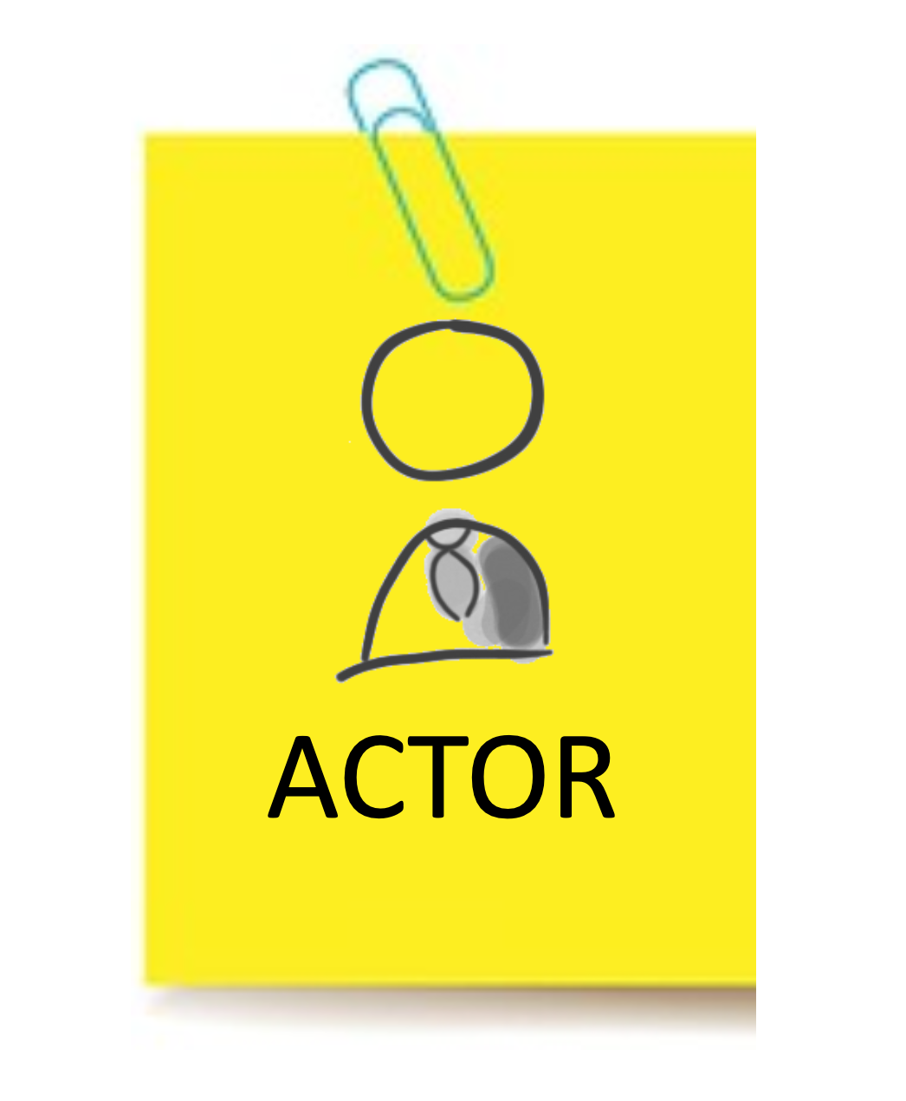

Slide 112
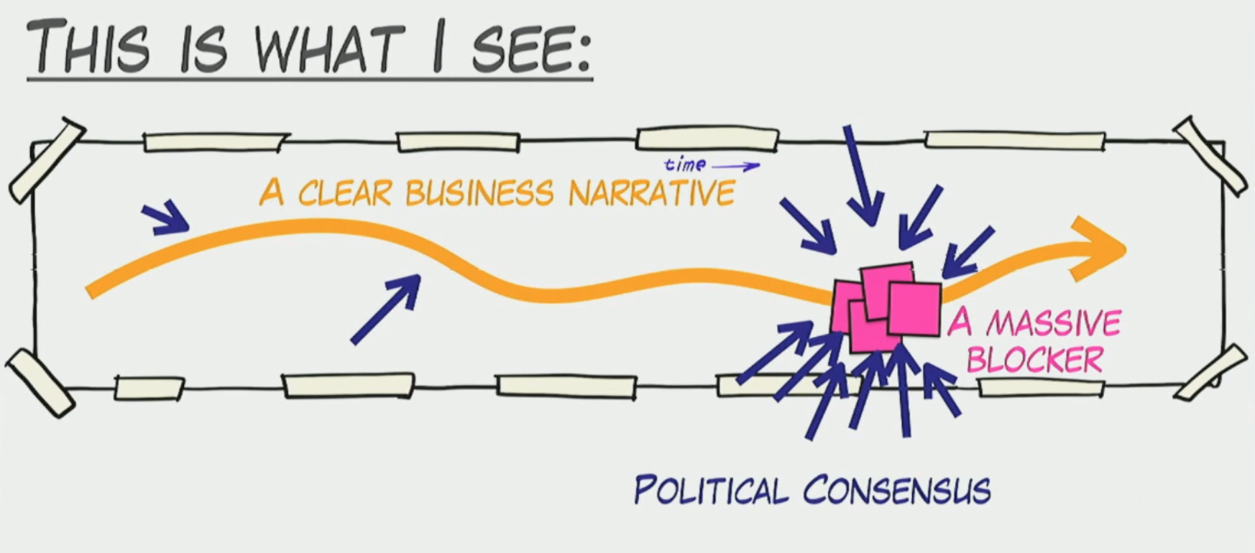

Slide 113
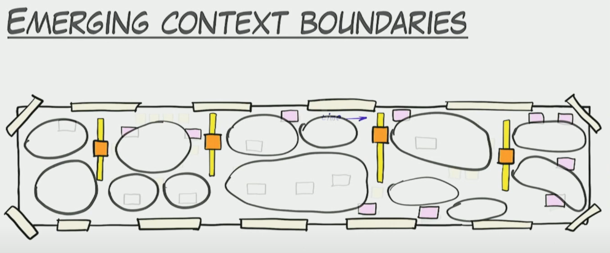

Slide 114
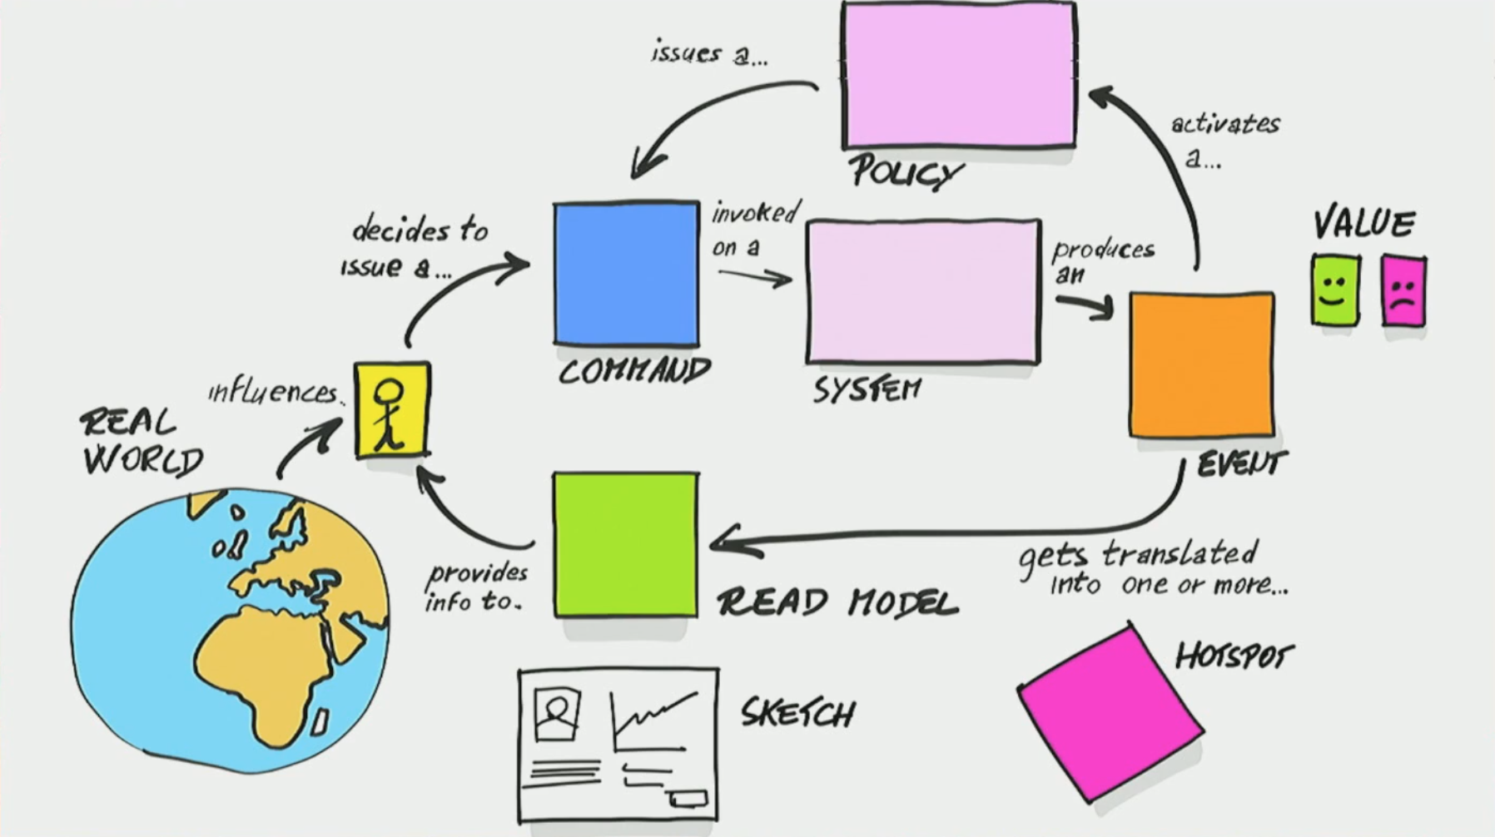

Slide 115
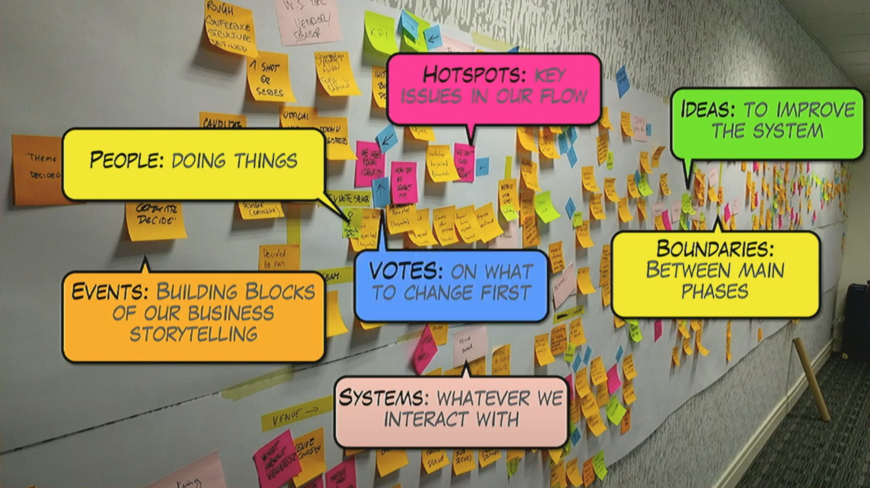
Notation

Slide 116

Tips and Trics

Slide 117
Create working architecture guild
Allow people to make decisions
Empower people by responsibility
Write down all of your decisions
Use RFCs

Slide 118
Learn Domain Driven Design
At least concept

Slide 119
Use Events Storming
Especially for green field projects

Slide 120
Whiteboard Iteration vs Sprint iteration
Whiteboard iteration 1 for technical task takes 30 mins
Sprint iteration usually takes 2 weeks
Try to prototype the solution with diagrams
Don’t do that alone – invite developers

Slide 121
Use YAGNI principle
Most of the time we struggle with something which we will not needed in the future
Remember about XP – extreme programming

Slide 122
Architecture Guild Meeting
Source: https://commons.wikimedia.org/wiki/File:Governors_of_the_Wine_Merchant%27s_Guild.jpg

Slide 123
Architecture Katas
Source: https://commons.wikimedia.org/wiki/File:Governors_of_the_Wine_Merchant%27s_Guild.jpg

Slide 124
Architecture Katas
http://fundamentalsofsoftwarearchitecture.com/katas/list.html

Slide 125

Summary of Day 1

Slide 126
Articles:
https://martinfowler.com/ieeeSoftware/whoNeedsArchitect.pdf
Architecture roadmaps:
https://github.com/AlaaAttya/software-architect-roadmap
https://github.com/justinamiller/SoftwareArchitect
https://www.infoq.com/articles/architecture-guild-800-friends/
https://chriskiehl.com/article/thoughts-after-6-years
https://www.thoughtworks.com/insights/blog/applying-conways-law-improve-your-software-development
https://radekmaziarka.pl/2021/03/14/conways-law-how-organizations-structure-influences-its-results/
https://www.thoughtworks.com/insights/blog/bff-soundcloud

Slide 127
Videos:
https://www.youtube.com/watch?v=jo46-CP6ywU
https://www.youtube.com/watch?v=x2-rSnhpw0g

Slide 128
Books:
Design Patterns: Elements of Reusable Object-Oriented Software [1994] by Erich Gamma, Richard Helm, Ralph Johnson, John Vlissides (Gang of Four a.k.a. GoF)
Clean Code: A Handbook of Agile Software Craftsmanship [2007] by Robert C. Martin (“Uncle Bob”)
Clean Architecture: A Craftsman’s Guide to Software Structure and Design [2016] by Robert C. Martin (“Uncle Bob”)
Refactoring: Improving the Design of Existing Code (2nd Edition) [2018] by Martin Fowler
The Pragmatic Programmer (2nd Edition): Your Journey to Mastery, 20th Anniversary Edition [2019] by Andrew Hunt, David Thomas
Domain-Driven Design: Tackling Complexity in the Heart of Software [2003] by Eric Evans
Building Microservices: Designing Fine-Grained Systems [2015] by Sam Newman
Designing Data-Intensive Applications [2015] by Martin Kleppmann
SRE | Site Reliability Engineering: How Google Runs Production Systems [2016] by Betsy Beyer, Niall Richard Murphy, Chris Jones, Jennifer Petoff
The Phoenix Project (A Novel About IT, DevOps, and Helping Your Business Win) [2018] by Gene Kim, Kevin Behr, George Spafford
Designing Event-Driven Systems [2018] by Ben Stopford

Slide 129
Courses:
https://droganowoczesnegoarchitekta.pl/

Slide 130
Miscs:
http://fundamentalsofsoftwarearchitecture.com/katas/list.html

Slide 131

Q&A

